Slide 1
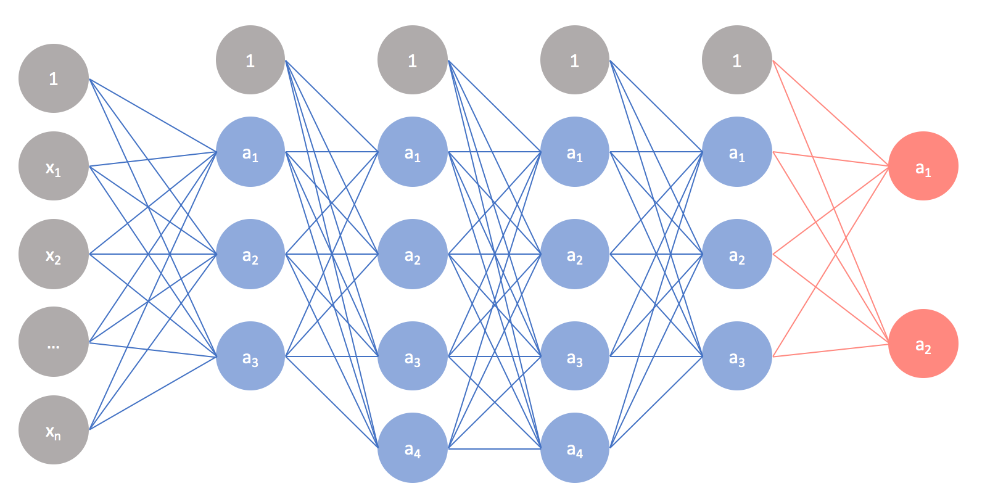
NN basics 2

Slide 2
References
http://cs231n.stanford.edu/index.html
http://www.cs.cornell.edu/courses/cs5670/2019sp/lectures/lectures.html
http://www.cs.cmu.edu/~16385/

Slide 3
A good fully connected example
https://playground.tensorflow.org/#activation=tanh&batchSize=10&dataset=spiral&regDataset=reg-plane&learningRate=0.03&regularizationRate=0&noise=0&networkShape=8,8,8&seed=0.68609&showTestData=false&discretize=false&percTrainData=50&x=true&y=true&xTimesY=true&xSquared=true&ySquared=true&cosX=false&sinX=true&cosY=false&sinY=true&collectStats=false&problem=classification&initZero=false&hideText=false

Slide 4
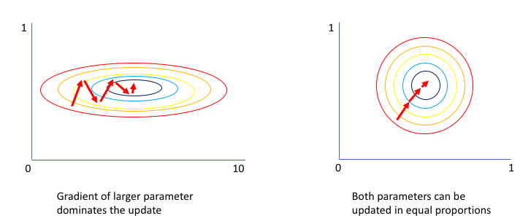
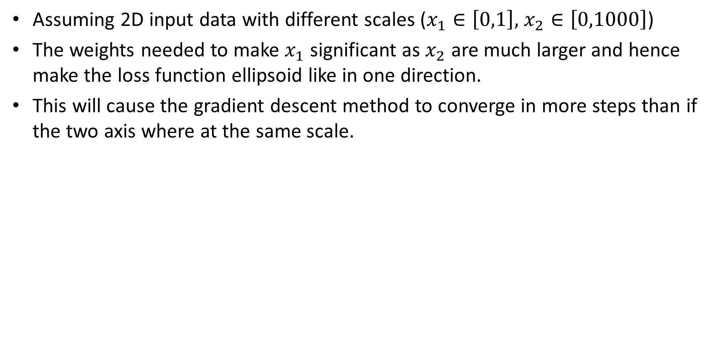
Data normalization
Assuming 2D input data with different scales ($x_{1}∈\left[0,1\right],$ $x_{2}∈\left[0,1000\right]$)
The weights needed to make $x_{1}$ significant as $x_{2}$ are much larger and hence make the loss function ellipsoid like in one direction.
This will cause the gradient descent method to converge in more steps than if the two axis where at the same scale.

Slide 5
Data normalization
Add w1 w2 for axis here

Slide 6
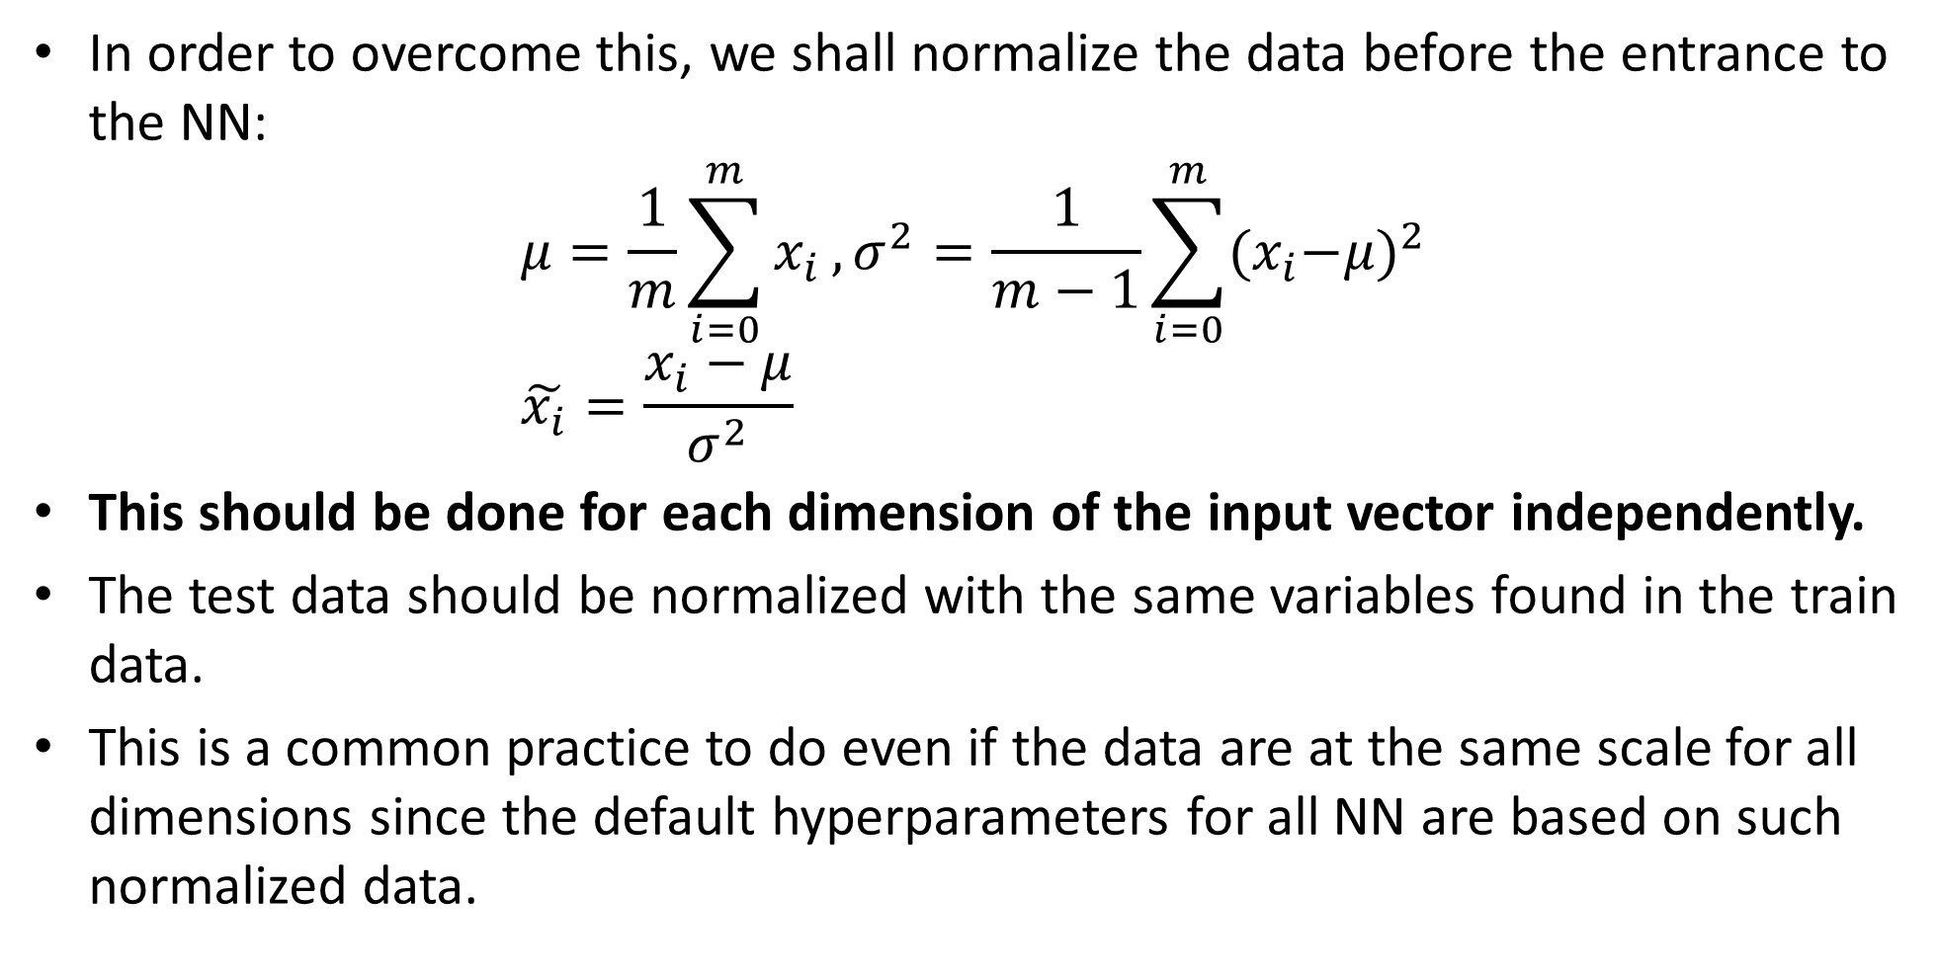
Data normalization
In order to overcome this, we shall normalize the data before the entrance to the NN:
$$μ=\frac{1}{m}\sum_{i=0}^{m}{x_{i}},σ^{2}=\frac{1}{m−1}\sum_{i=0}^{m}{{{(x}_{i}−μ)}^{2}} \\ \tilde{x_{i}}=\frac{x_{i}−μ}{σ^{2}}$$
This should be done for each dimension of the input vector independently.
The test data should be normalized with the same variables found in the train data.
This is a common practice to do even if the data are at the same scale for all dimensions since the default hyperparameters for all NN are based on such normalized data.

Slide 7
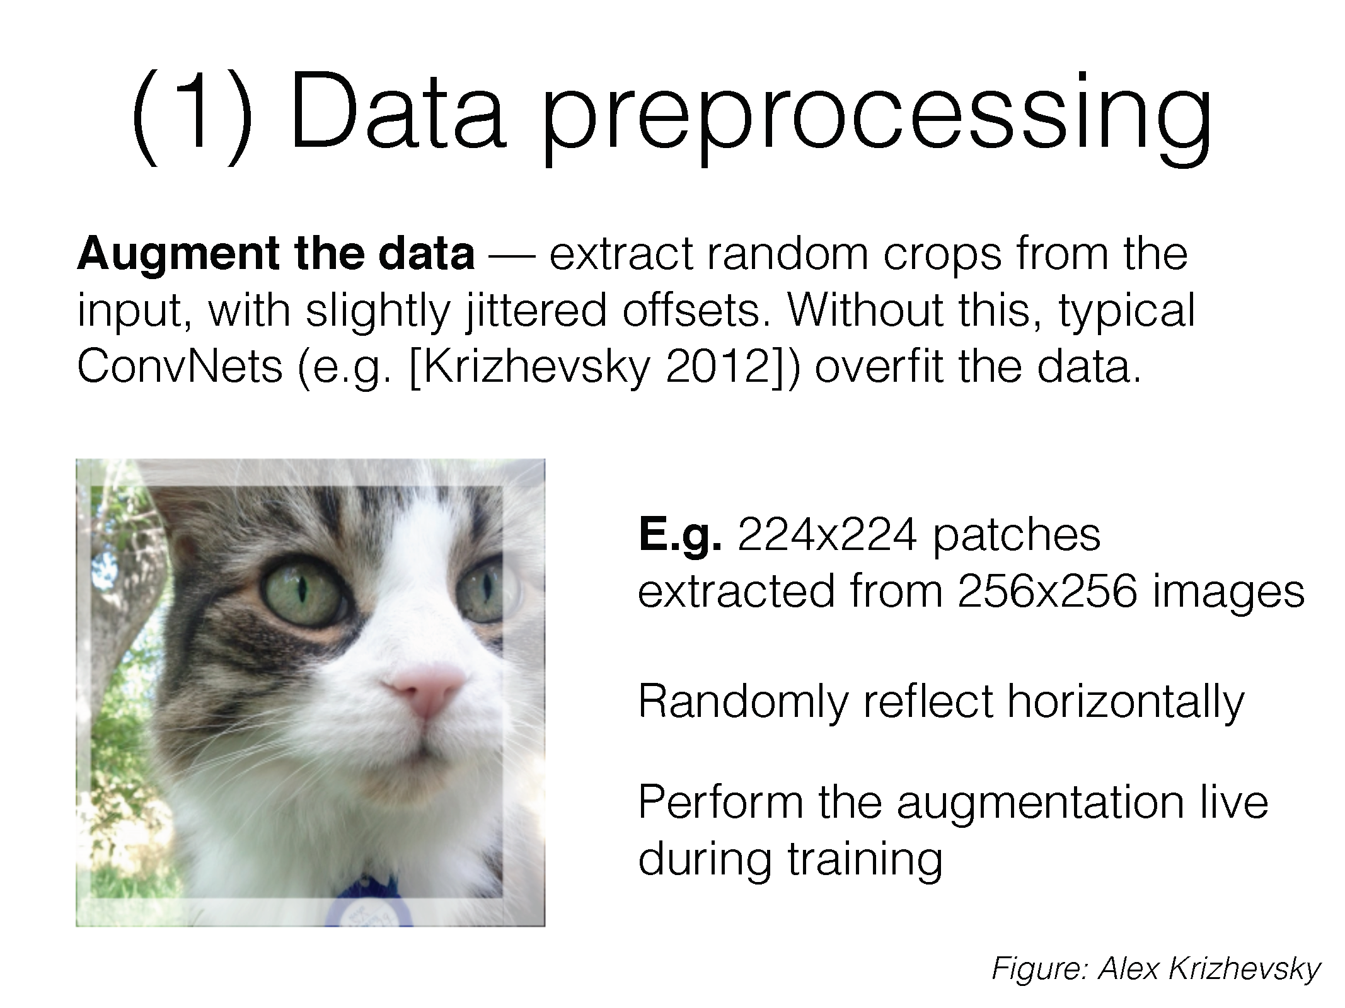
Data augmentation

Slide 8
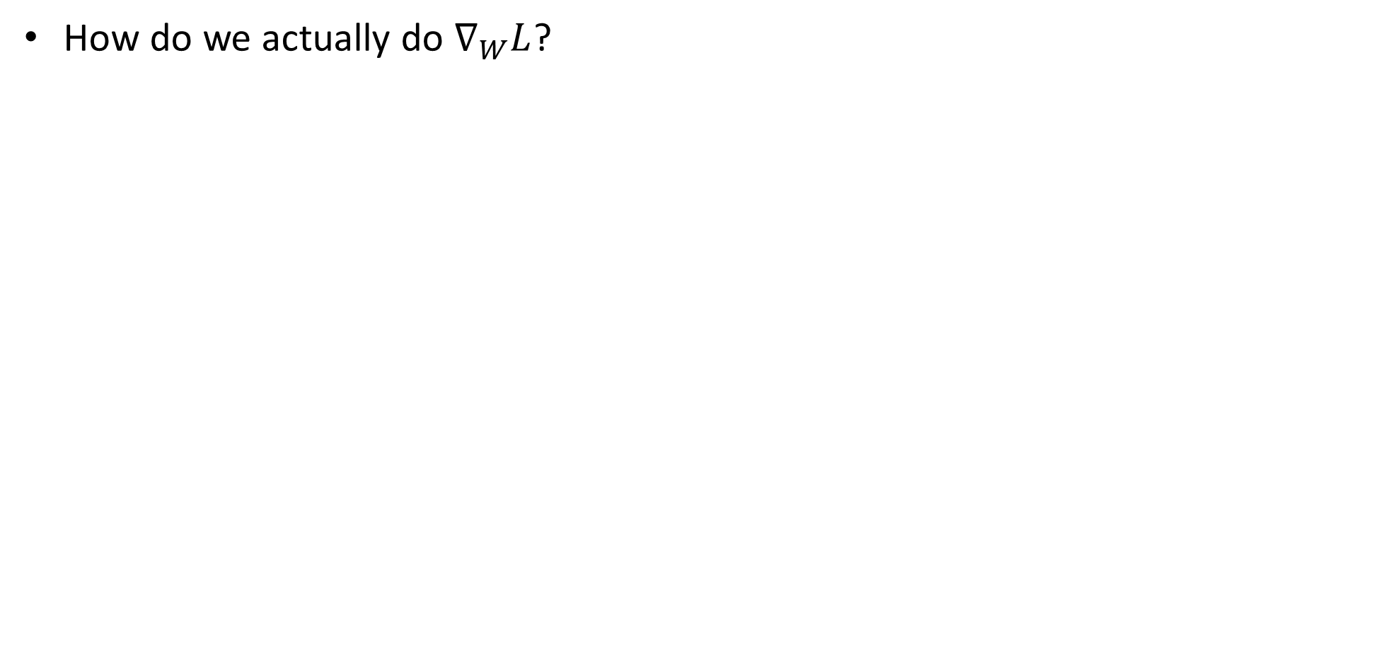
Loss derivation
How do we actually do $∇_{W}L$?

Slide 9
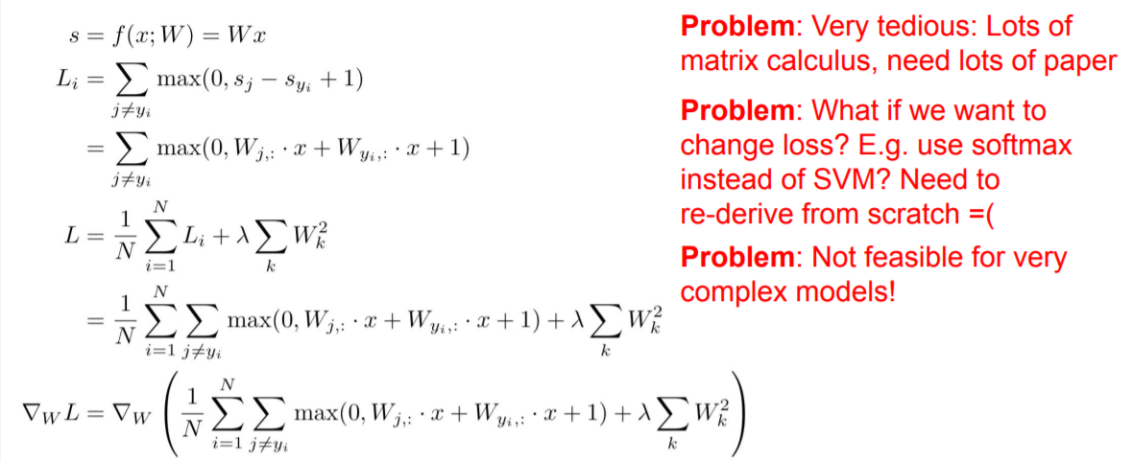
Bad idea- by hand

Slide 10
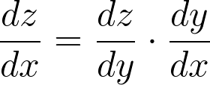
Good idea- back propagation
We are using the chain rule for gradient calculation:
Notes:
\frac{dz}{dx} = \frac{dz}{dy} \cdot \frac{dy}{dx}

Slide 11
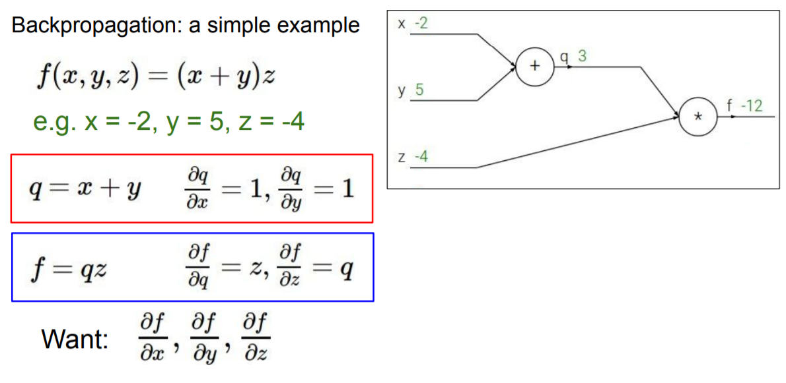

Slide 13
This is called- the forward pass

Slide 14
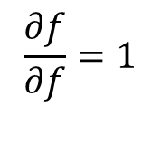
1
Step 0: initialization
$$\frac{∂f}{∂f}=1$$

Slide 15
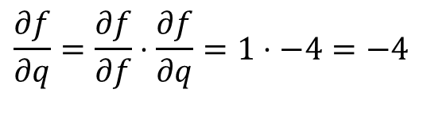
-4
junction
1
Iterative step: chain rule on locale junction.
$$\frac{∂f}{∂q}=\frac{∂f}{∂f}⋅\frac{∂f}{∂q}=1⋅−4=−4$$

Slide 16
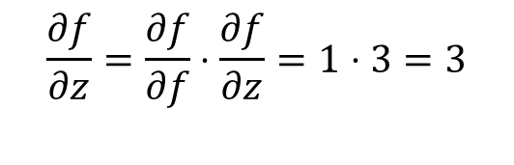
-4
junction
1
3
Iterative step: chain rule on locale junction.
$$\frac{∂f}{∂z}=\frac{∂f}{∂f}⋅\frac{∂f}{∂z}=1⋅3=3$$

Slide 17

-4
junction
1
3
Iterative step: chain rule on locale junction.
$$\frac{∂f}{∂z}=\frac{∂f}{∂f}⋅\frac{∂f}{∂z}=1⋅3=3$$

Slide 18
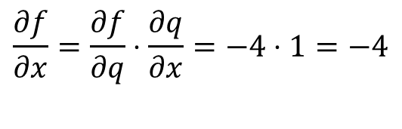
junction
-4
-4
1
3
Iterative step: chain rule on locale junction.
$$\frac{∂f}{∂x}=\frac{∂f}{∂q}⋅\frac{∂q}{∂x}=−4⋅1=−4$$

Slide 19
junction
-4
-4
1
3
Iterative step: chain rule on locale junction.
$$\frac{∂f}{∂x}=\frac{∂f}{∂q}⋅\frac{∂q}{∂x}=−4⋅1=−4$$

Slide 20
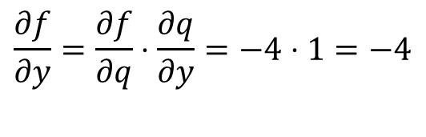
junction
-4
-4
-4
1
3
Iterative step: chain rule on locale junction.
$$\frac{∂f}{∂y}=\frac{∂f}{∂q}⋅\frac{∂q}{∂y}=−4⋅1=−4$$

Slide 21
junction
-4
-4
-4
1
3
Iterative step: chain rule on locale junction.
$$\frac{∂f}{∂y}=\frac{∂f}{∂q}⋅\frac{∂q}{∂y}=−4⋅1=−4$$

Slide 22
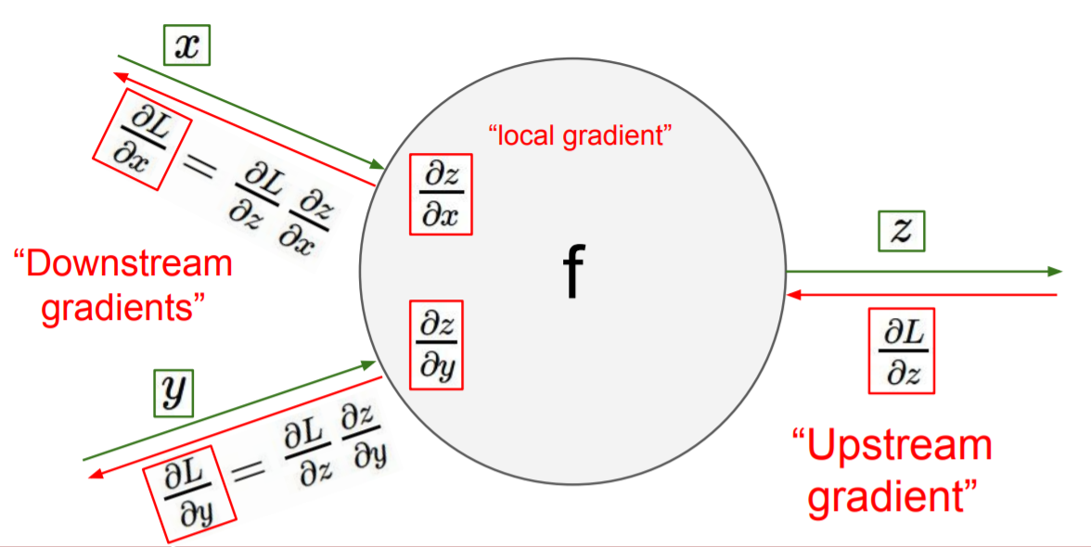
Backpropagation- conclusions
All that we need to know in each junction is:
The local gradient from the junction’s equation.
the chain rule result that was “back propagated” to the junction.

Slide 23
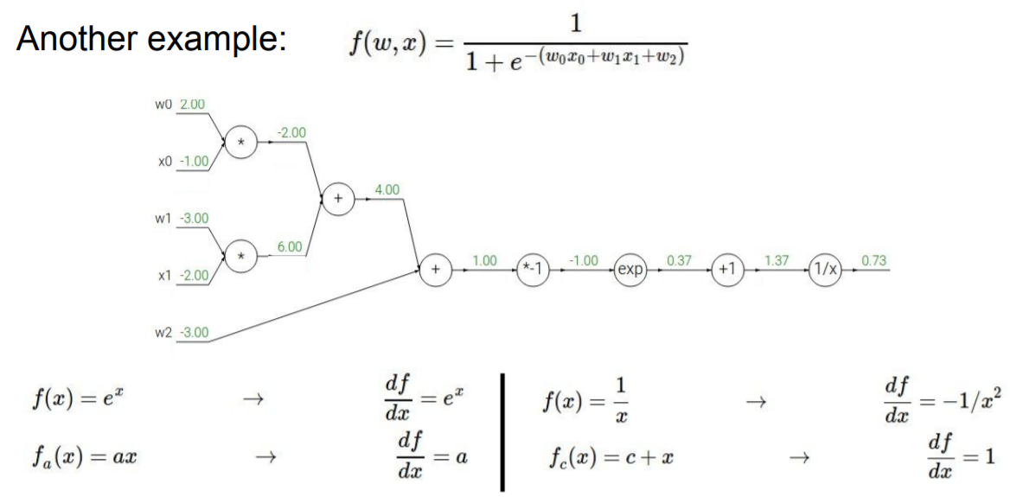
1

Slide 24
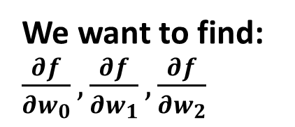
We want to find: $\frac{∂f}{∂w_{0}},\frac{∂f}{∂w_{1}},\frac{∂f}{∂w_{2}}$
1

Slide 25
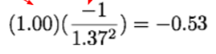
We want to find: $\frac{∂f}{∂w_{0}},\frac{∂f}{∂w_{1}},\frac{∂f}{∂w_{2}}$
-0.53
1

Slide 26
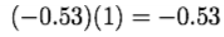
We want to find: $\frac{∂f}{∂w_{0}},\frac{∂f}{∂w_{1}},\frac{∂f}{∂w_{2}}$
-0.53
-0.53
1

Slide 27
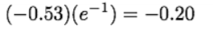
We want to find: $\frac{∂f}{∂w_{0}},\frac{∂f}{∂w_{1}},\frac{∂f}{∂w_{2}}$
-0.2
-0.53
-0.53
1

Slide 28
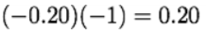
We want to find: $\frac{∂f}{∂w_{0}},\frac{∂f}{∂w_{1}},\frac{∂f}{∂w_{2}}$
0.2
-0.2
-0.53
-0.53
1

Slide 29
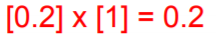
We want to find: $\frac{∂f}{∂w_{0}},\frac{∂f}{∂w_{1}},\frac{∂f}{∂w_{2}}$
0.2
0.2
-0.2
-0.53
-0.53
1

Slide 30
We want to find: $\frac{∂f}{∂w_{0}},\frac{∂f}{∂w_{1}},\frac{∂f}{∂w_{2}}$
0.2
0.2
-0.2
-0.53
-0.53
1
0.2

Slide 31
We want to find: $\frac{∂f}{∂w_{0}},\frac{∂f}{∂w_{1}},\frac{∂f}{∂w_{2}}$
0.2
0.2
0.2
-0.2
-0.53
-0.53
1
0.2

Slide 32
We want to find: $\frac{∂f}{∂w_{0}},\frac{∂f}{∂w_{1}},\frac{∂f}{∂w_{2}}$
0.2
0.2
0.2
0.2
-0.2
-0.53
-0.53
1
0.2

Slide 33
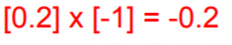
We want to find: $\frac{∂f}{∂w_{0}},\frac{∂f}{∂w_{1}},\frac{∂f}{∂w_{2}}$
-0.2
0.2
0.2
0.2
0.2
-0.2
-0.53
-0.53
1
0.2

Slide 34
We want to find: $\frac{∂f}{∂w_{0}},\frac{∂f}{∂w_{1}},\frac{∂f}{∂w_{2}}$
-0.2
0.2
[0.2]*[-2]=-0.4
0.2
-0.4
0.2
0.2
-0.2
-0.53
-0.53
1
0.2

Slide 35
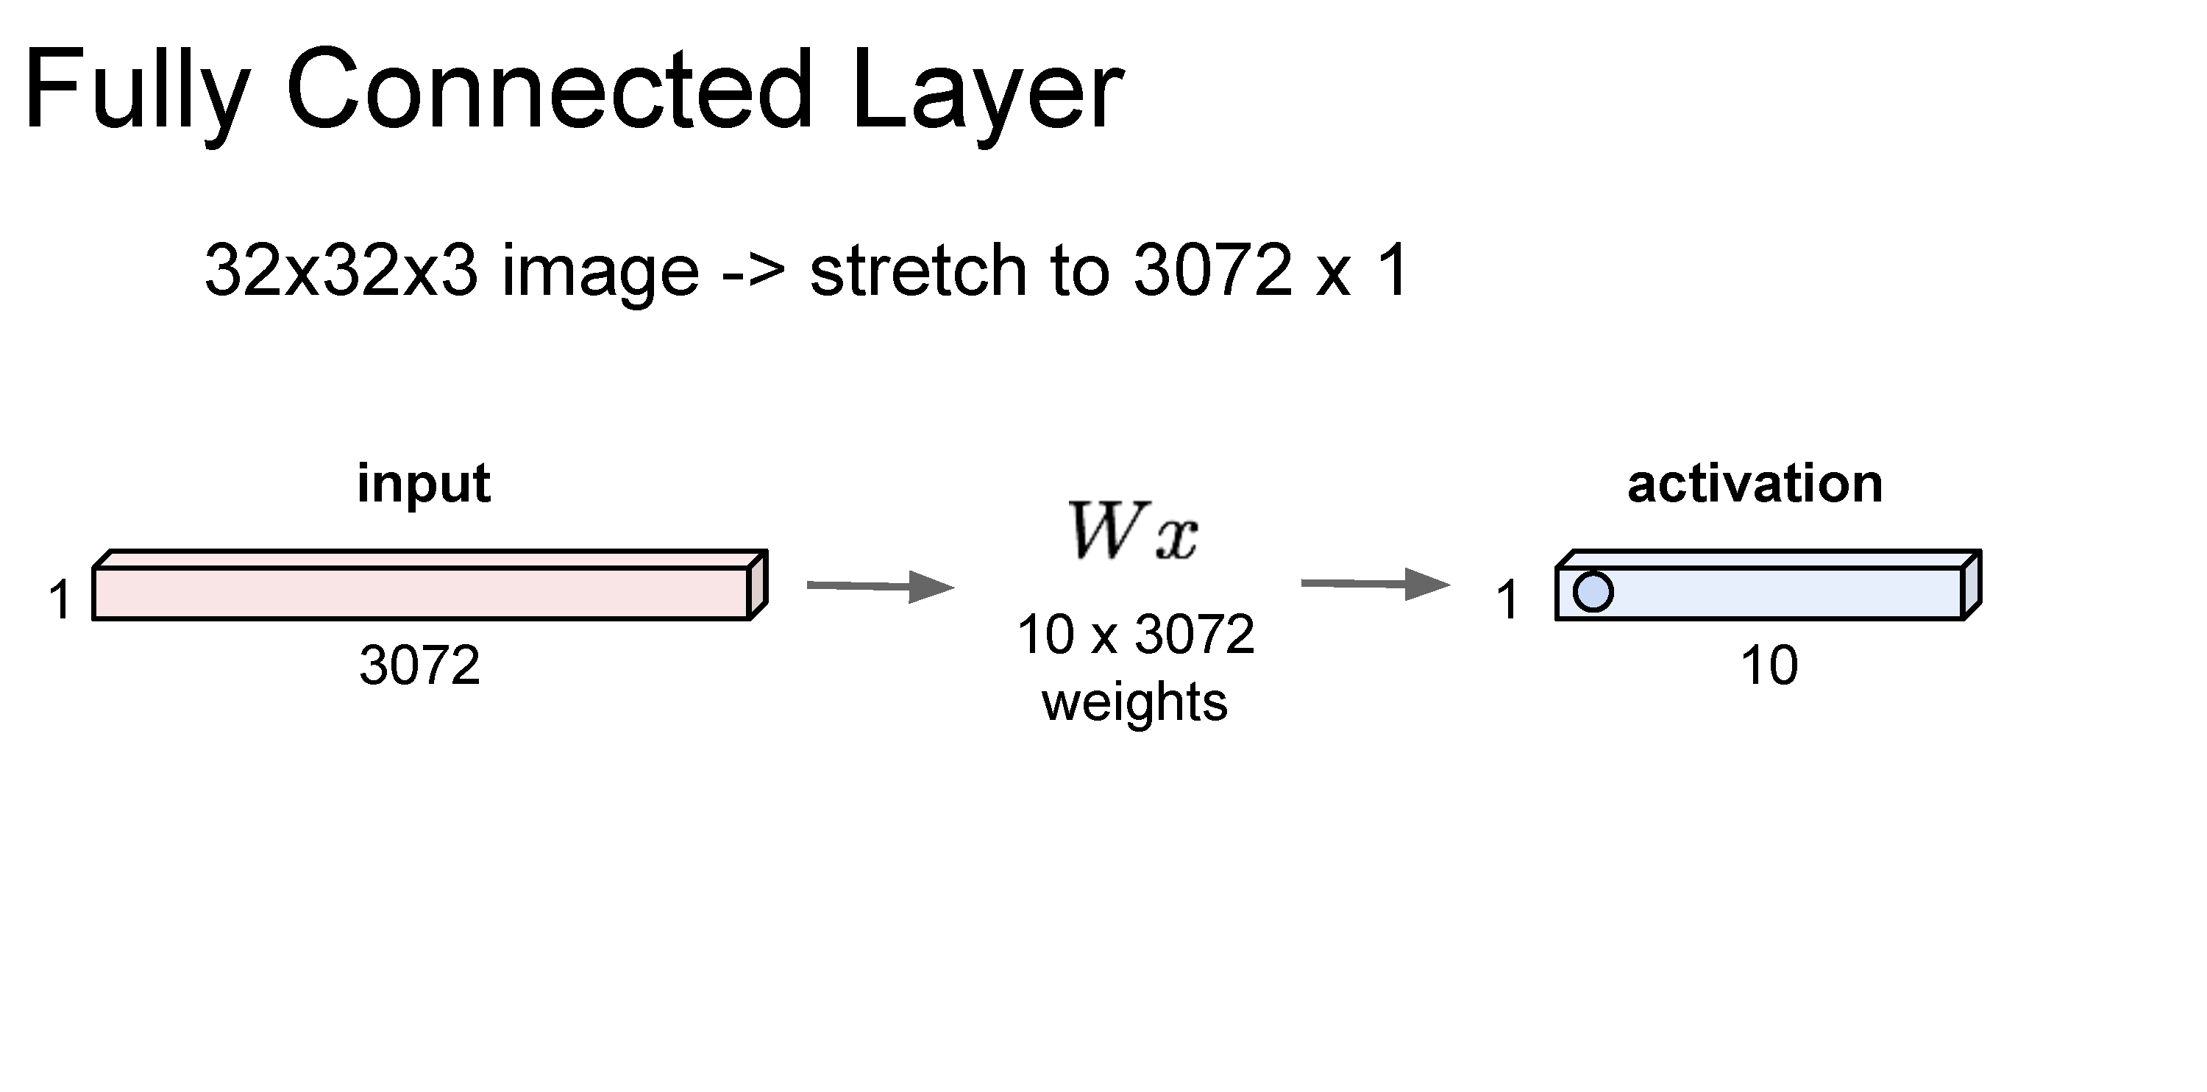

Slide 36
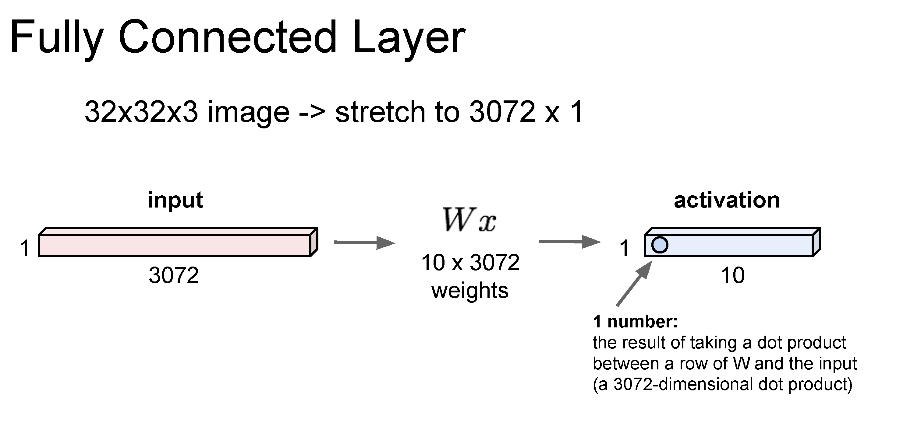
Same as a linear classifier!

Slide 37
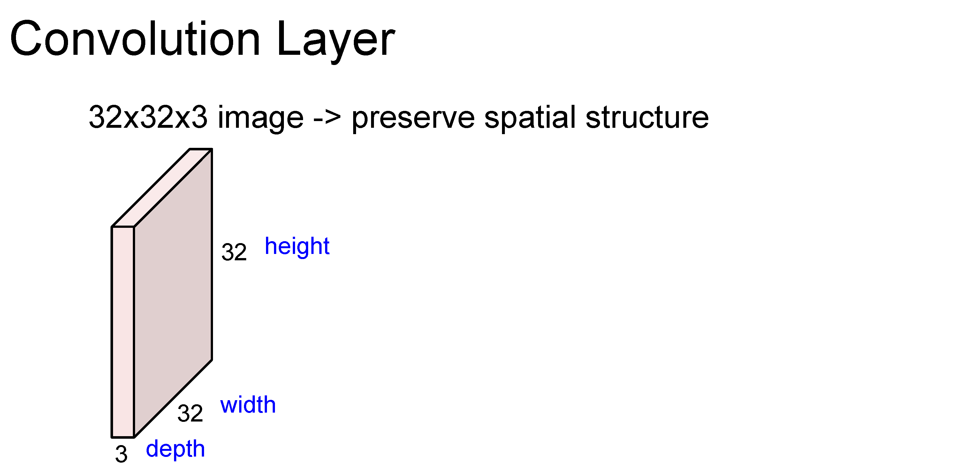

Slide 38
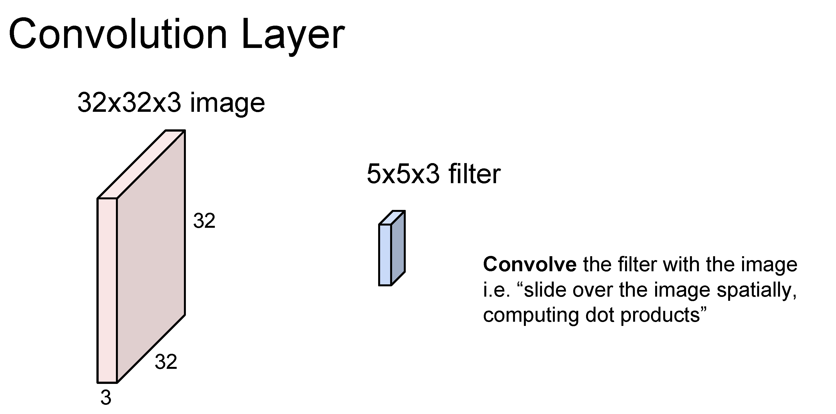

Slide 39
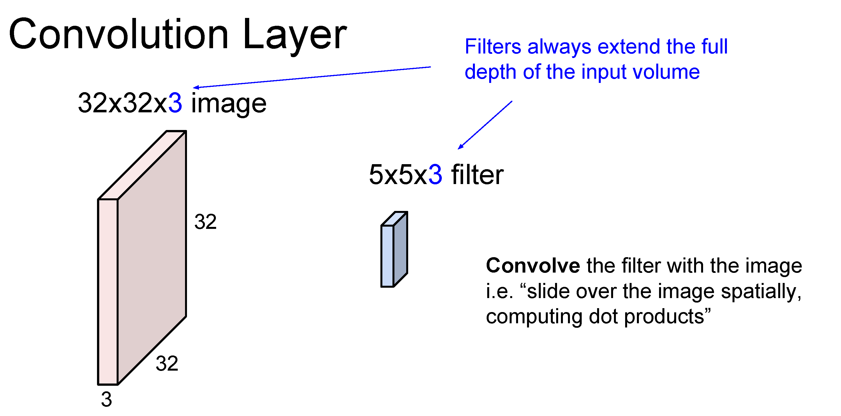

Slide 40
Number of weights: 5 x 5 x 3 + 1 = 76
(vs. 3072 for a fully-connected layer)
(+1 for bias)

Slide 41
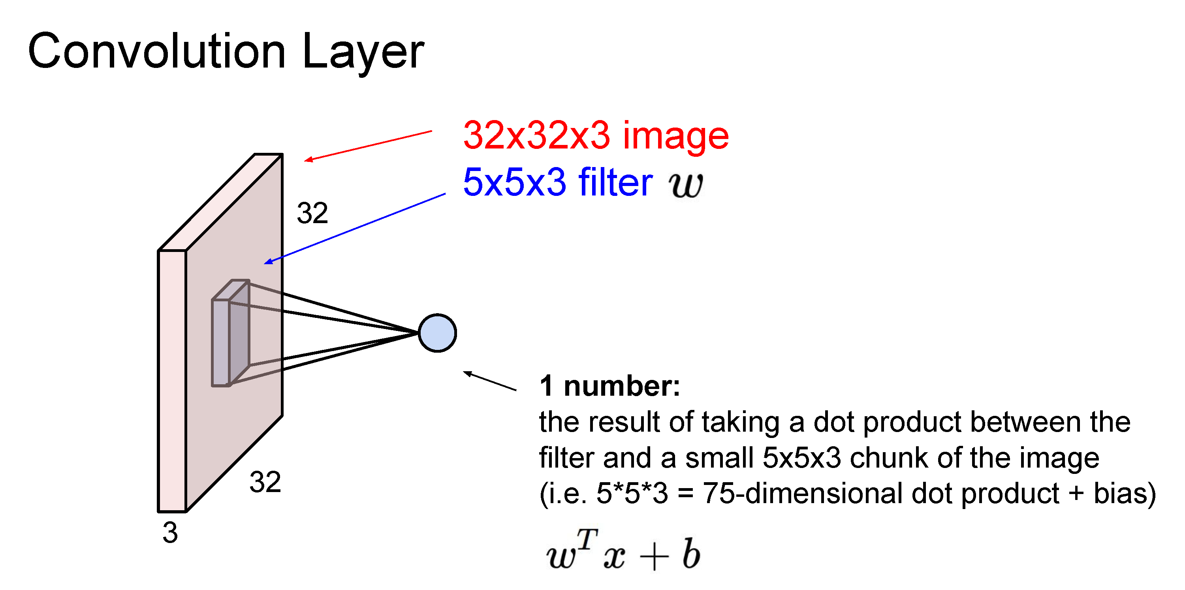

Slide 42
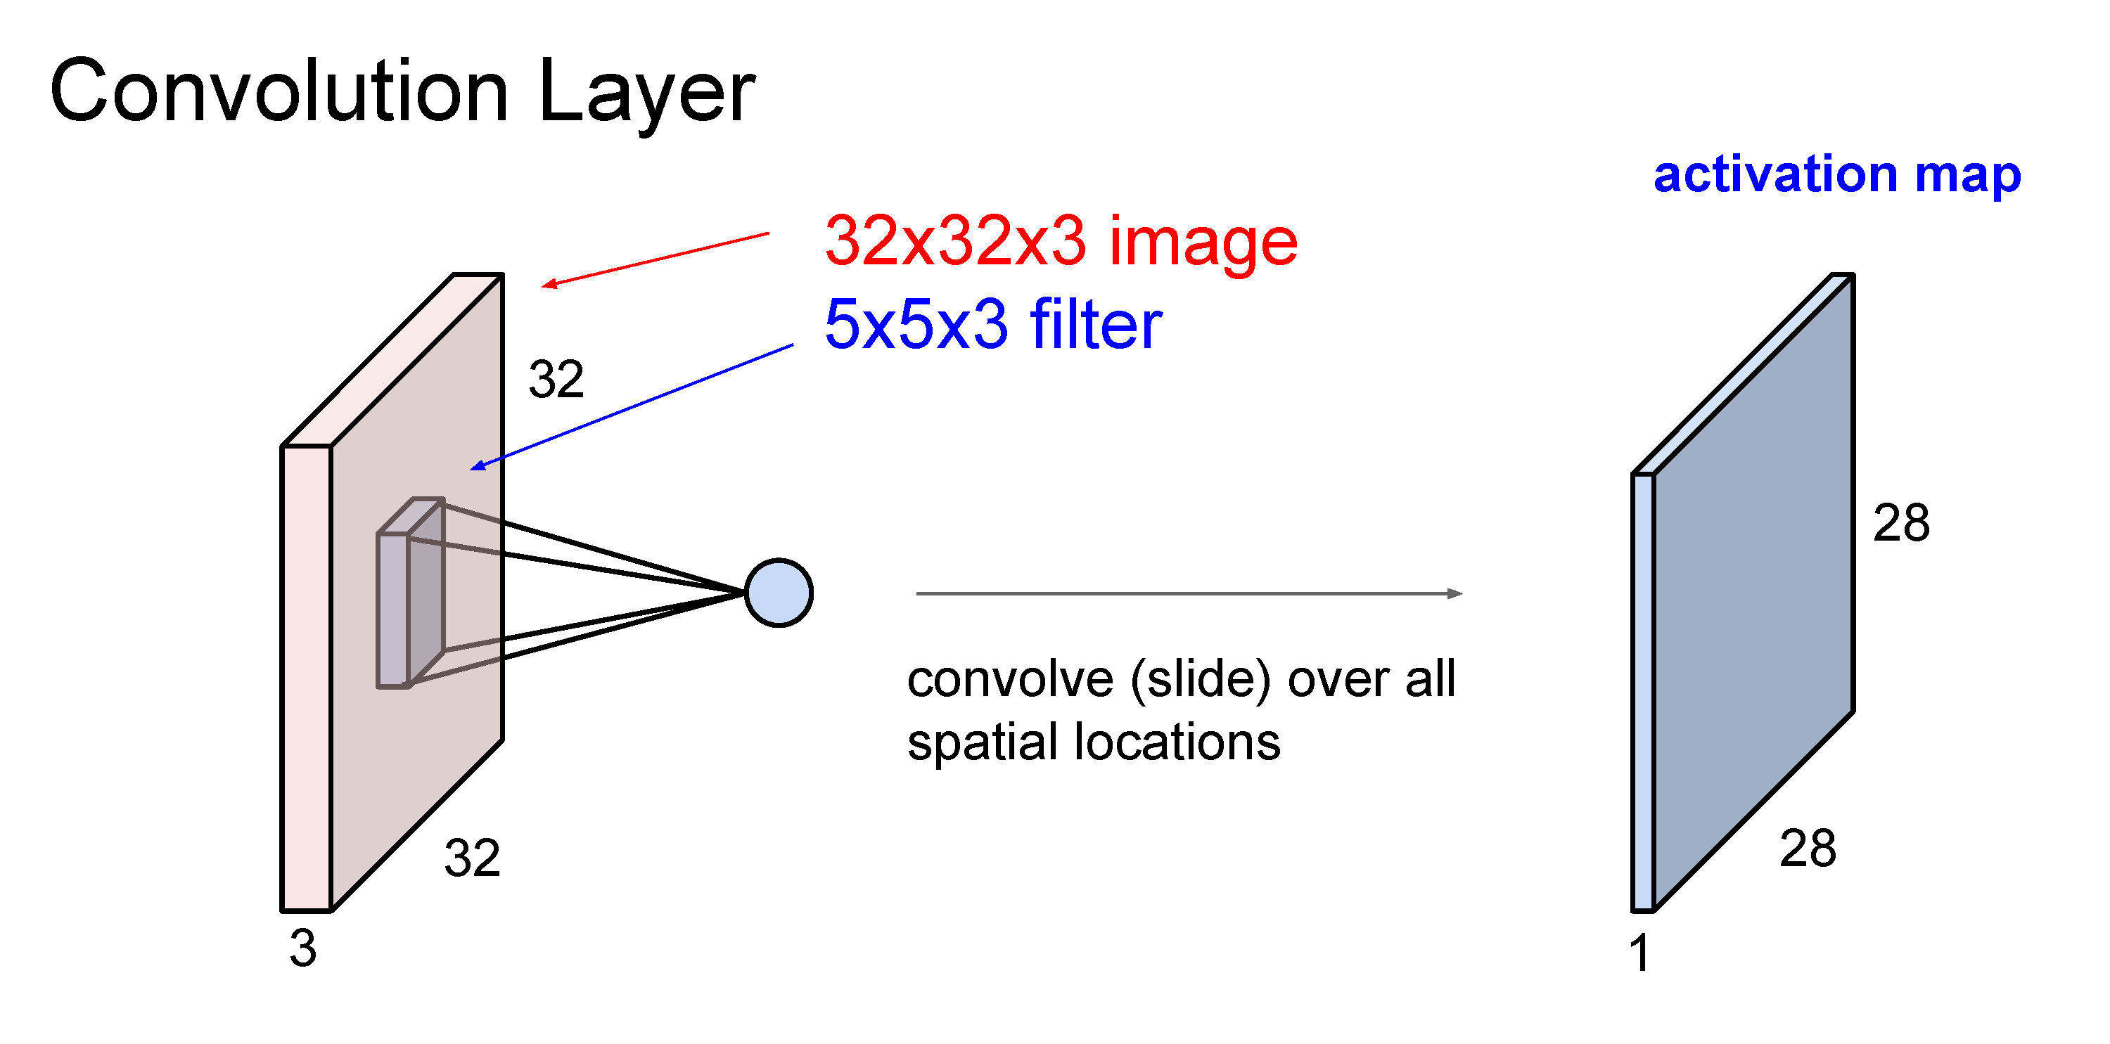

Slide 43
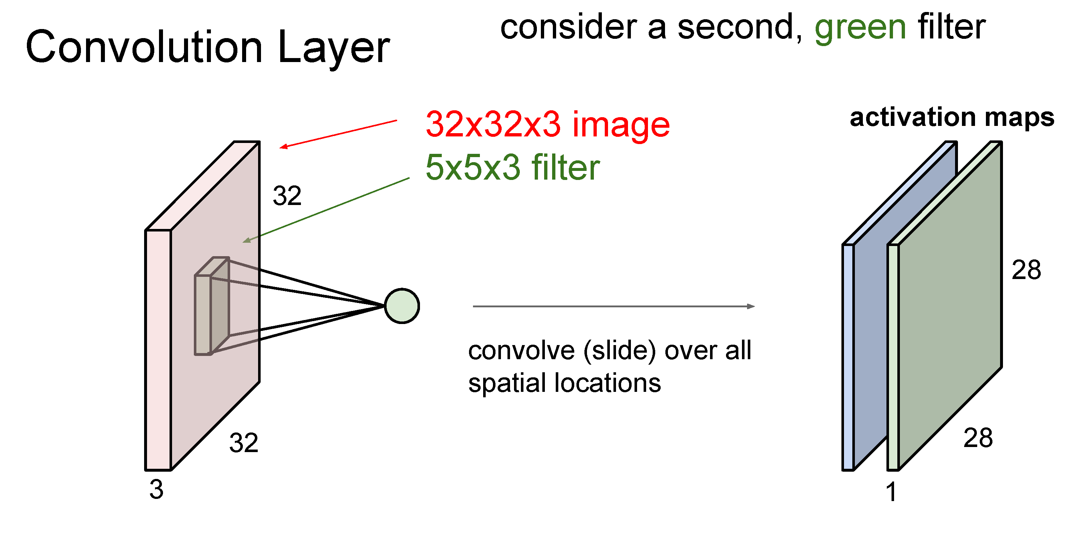

Slide 44
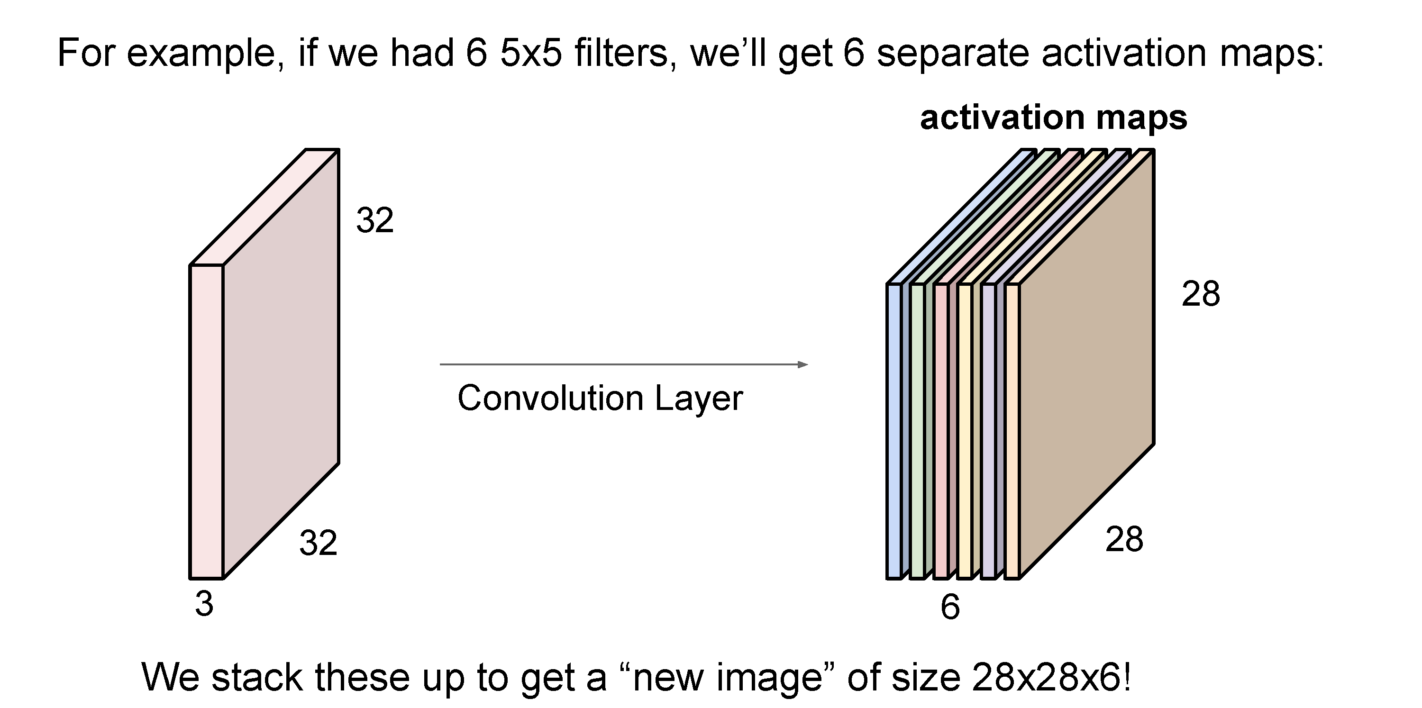
(total number of parameters: 6 x (75 + 1) = 456)

Slide 45
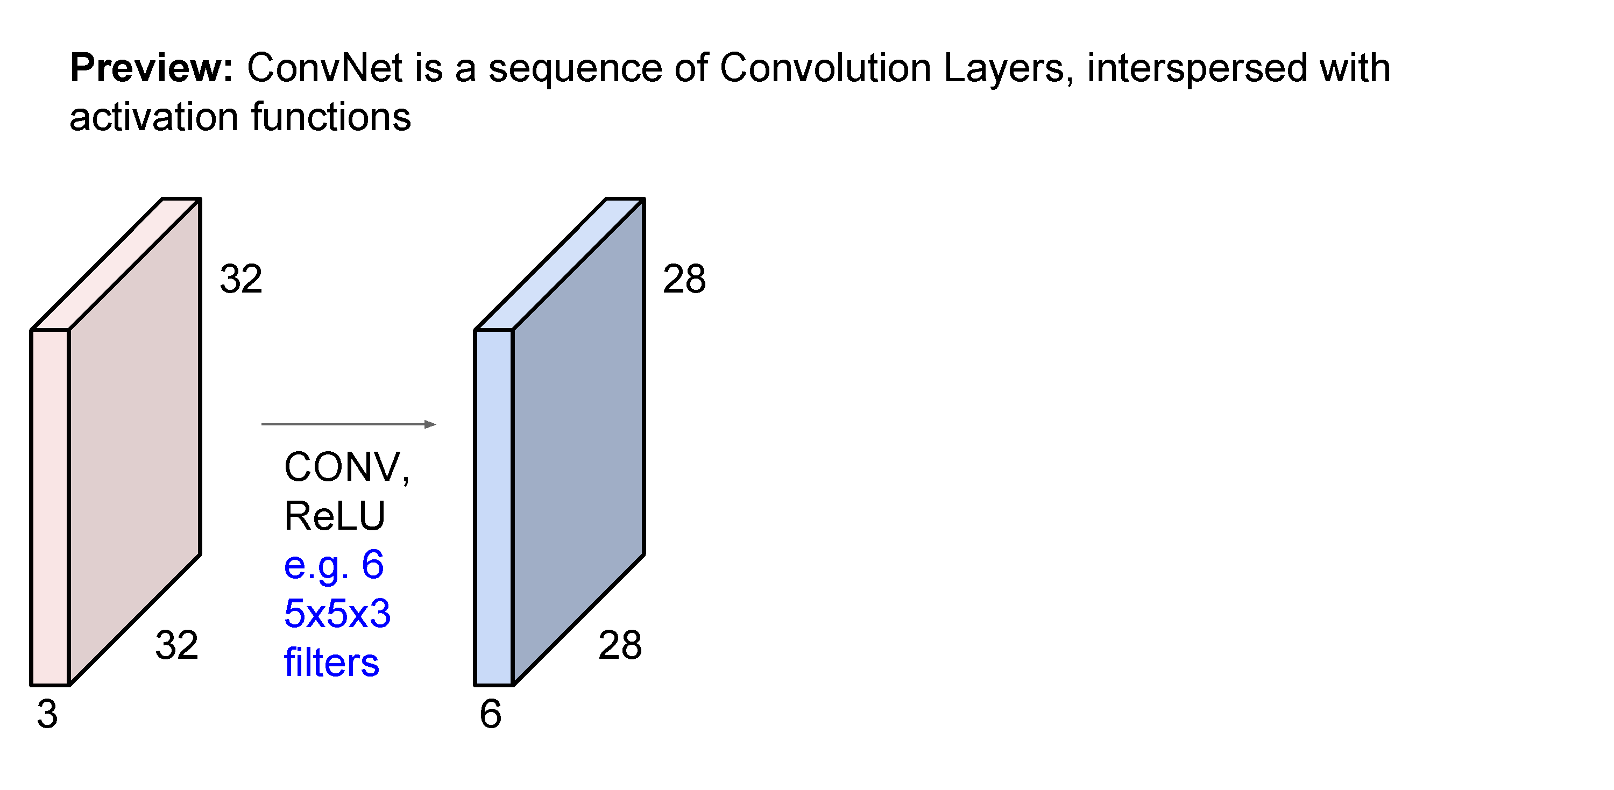

Slide 46
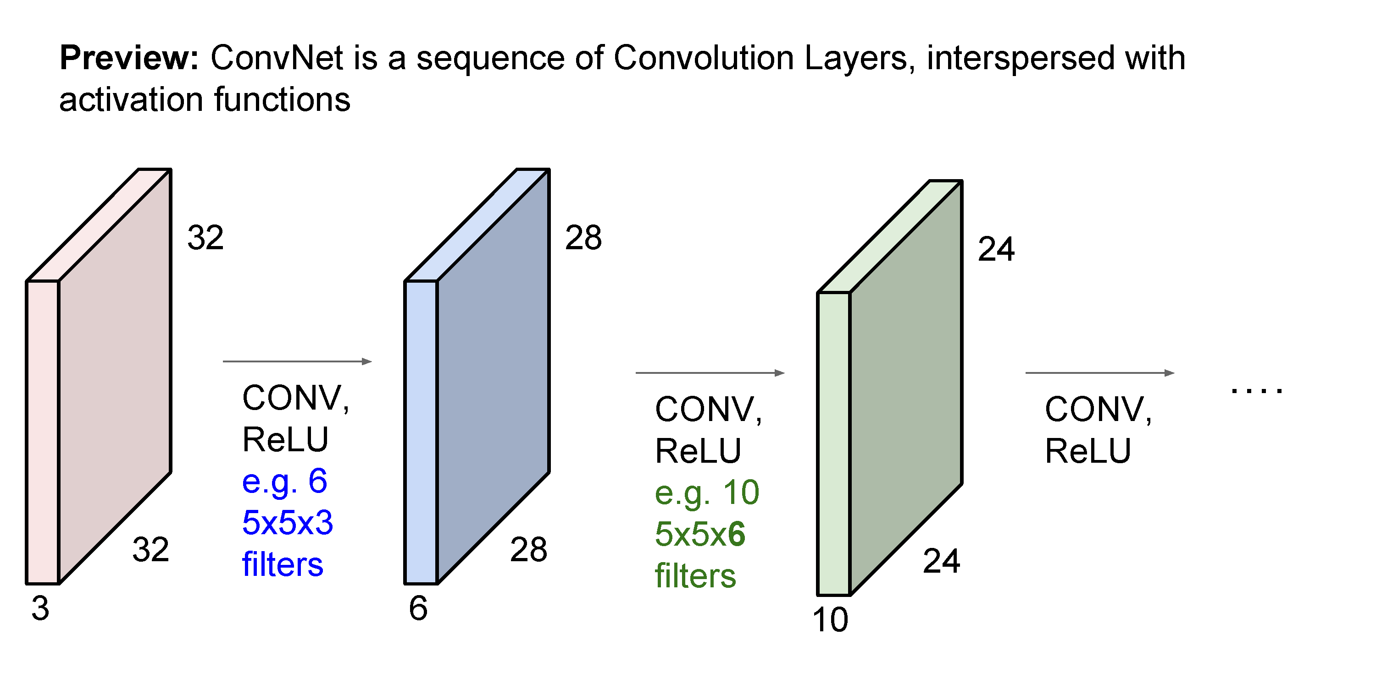

Slide 47
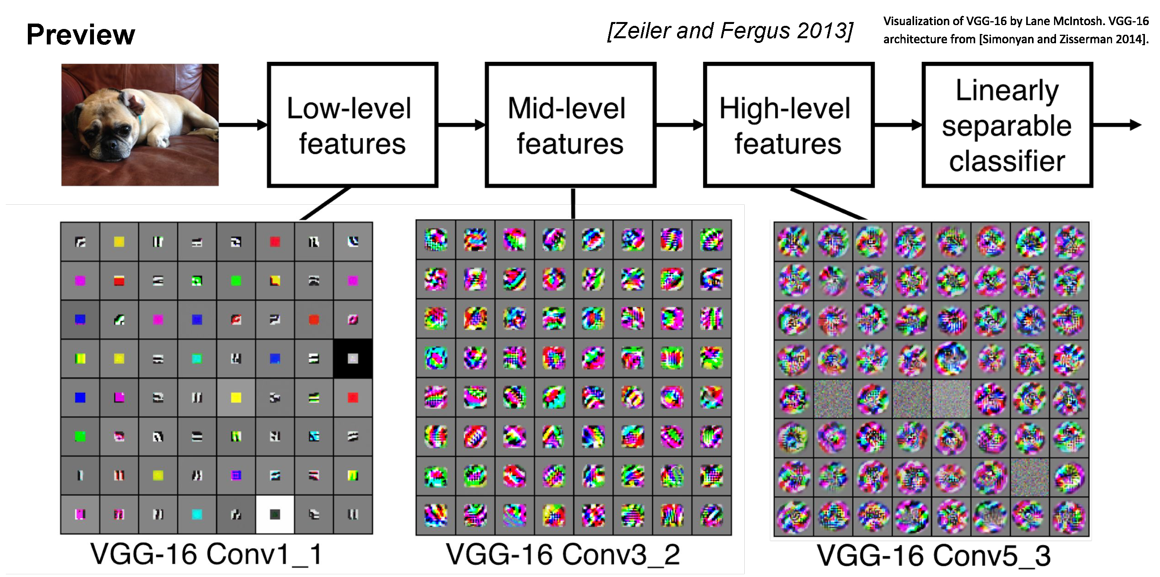

Slide 48
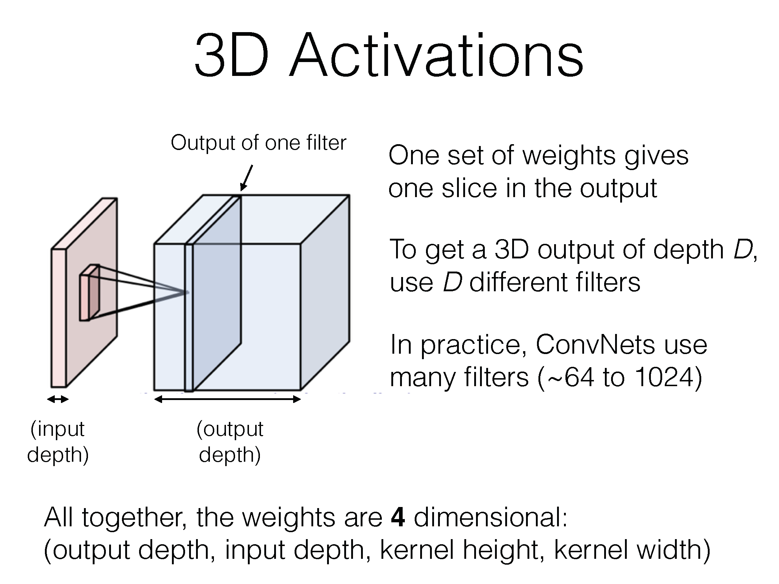

Slide 49
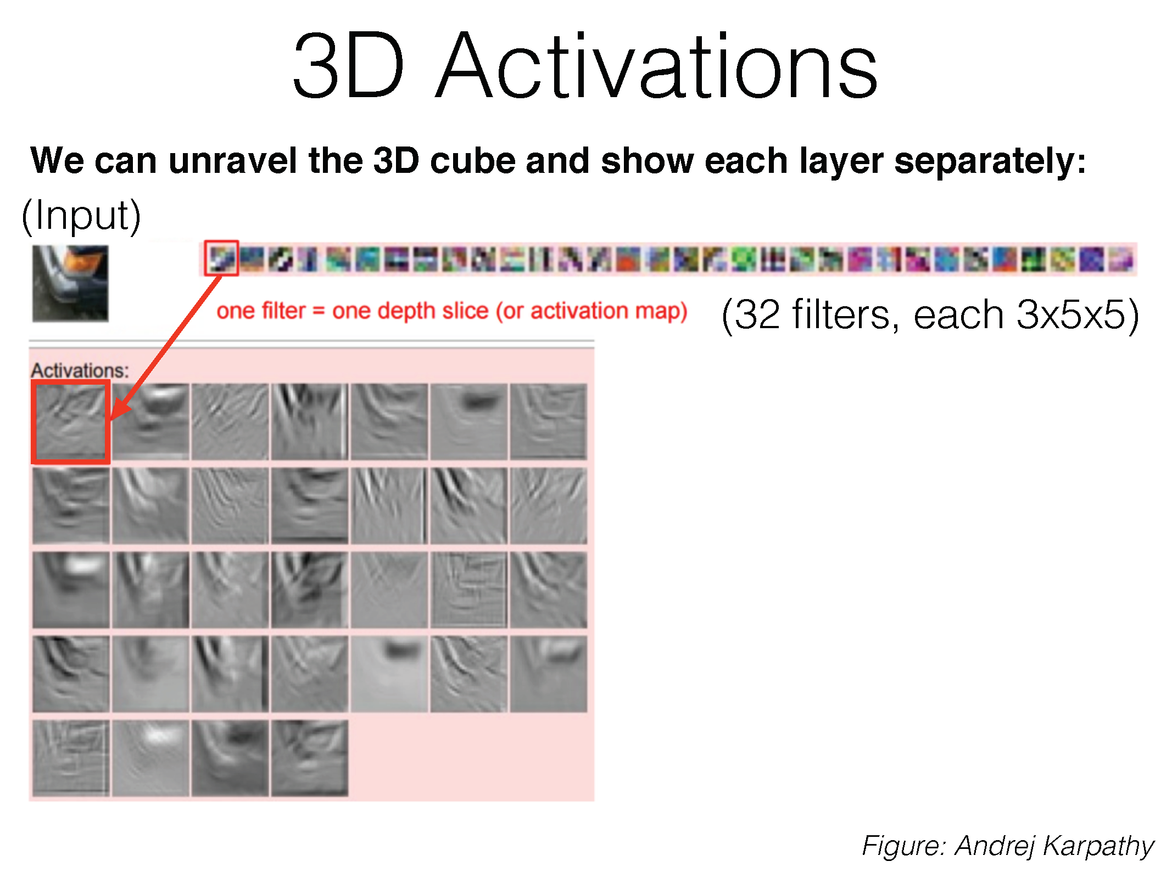

Slide 50
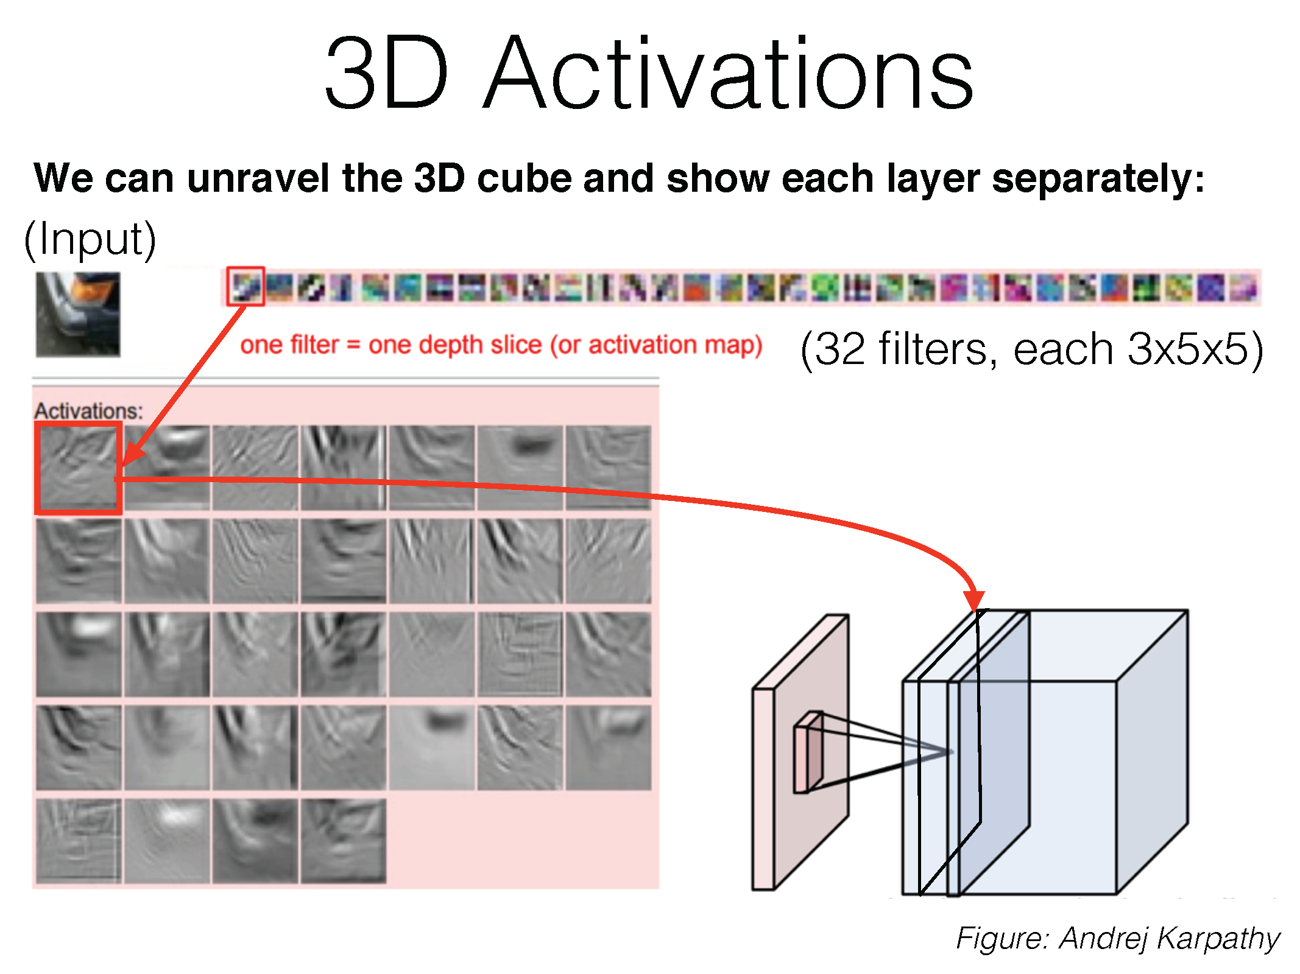

Slide 51
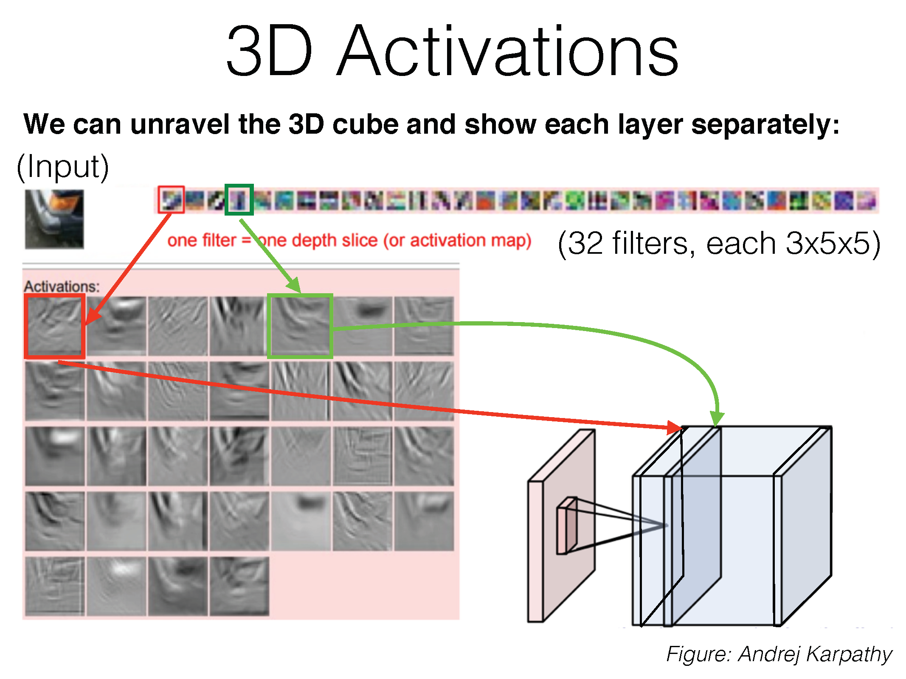

Slide 52
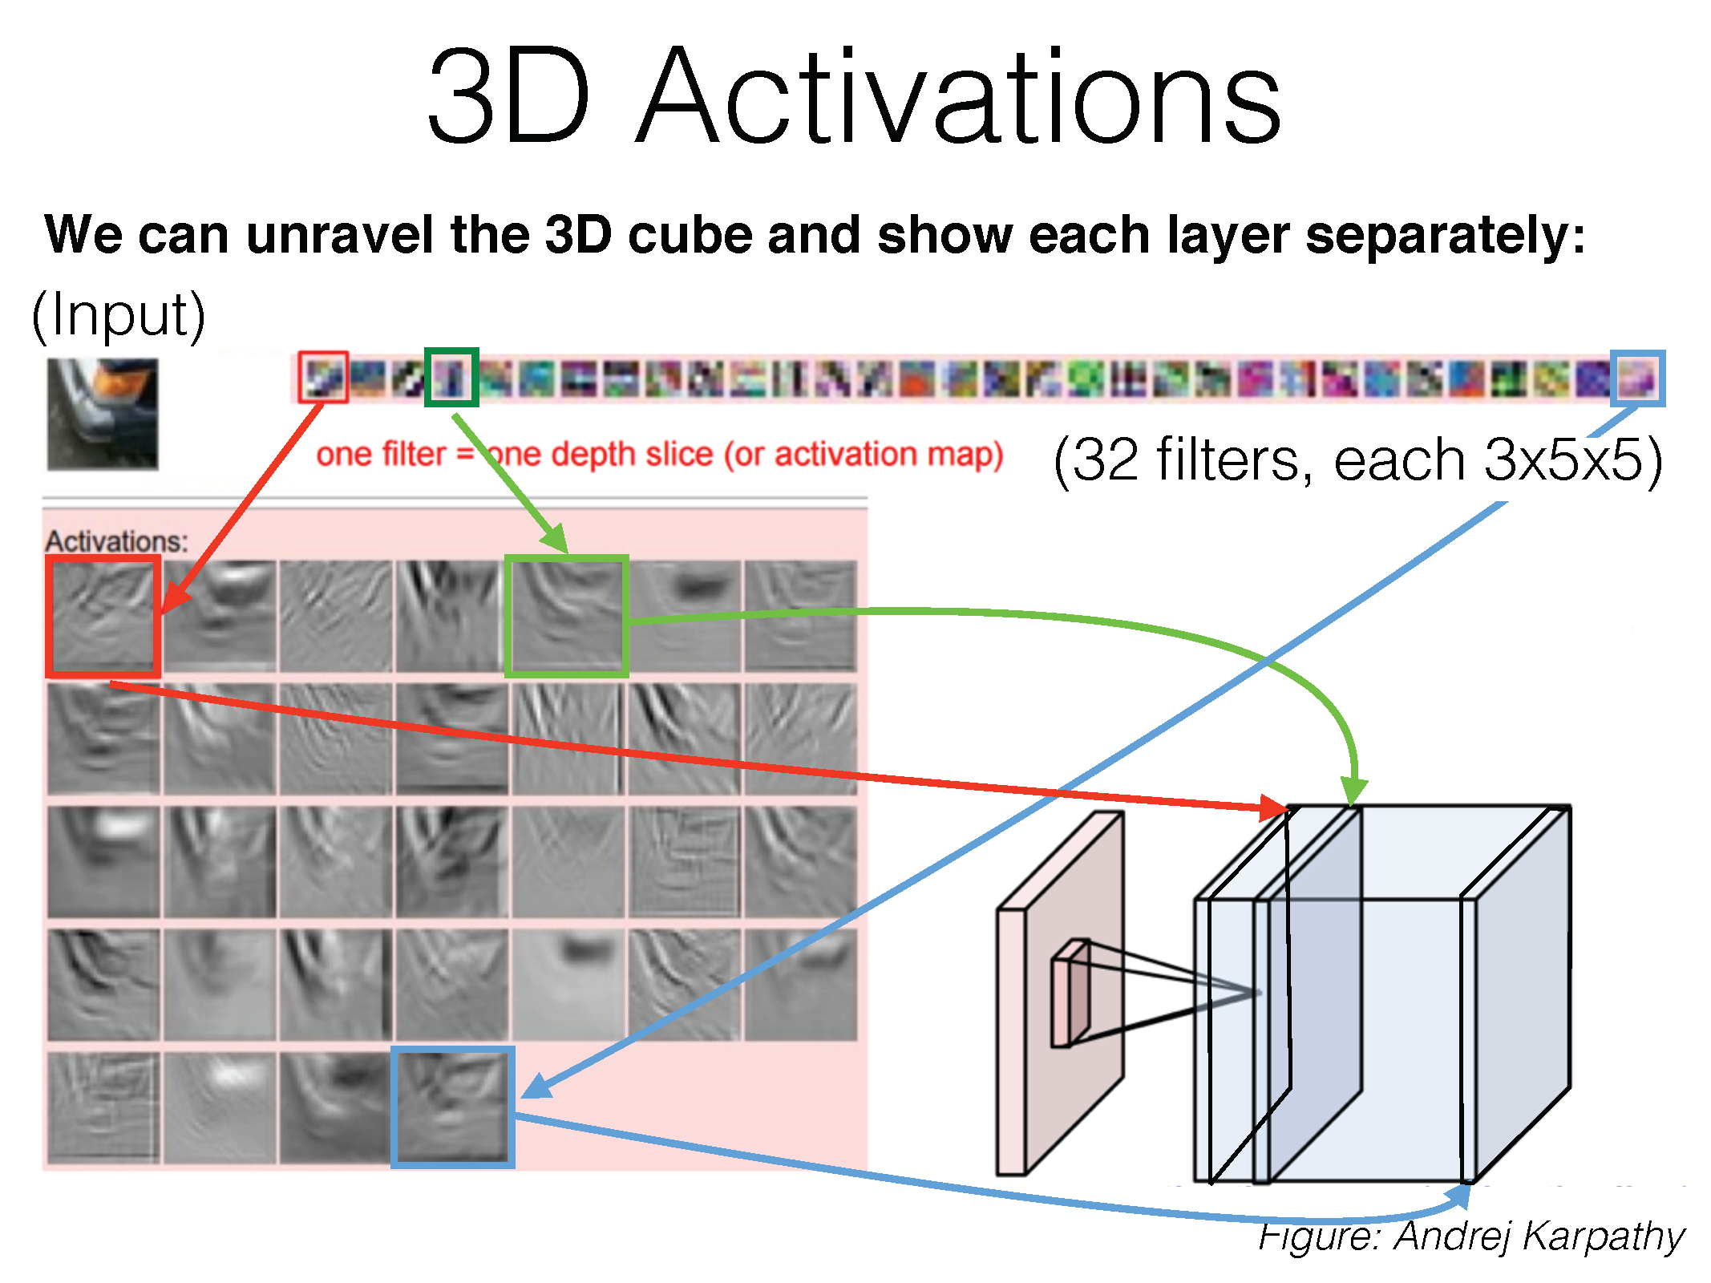

Slide 53
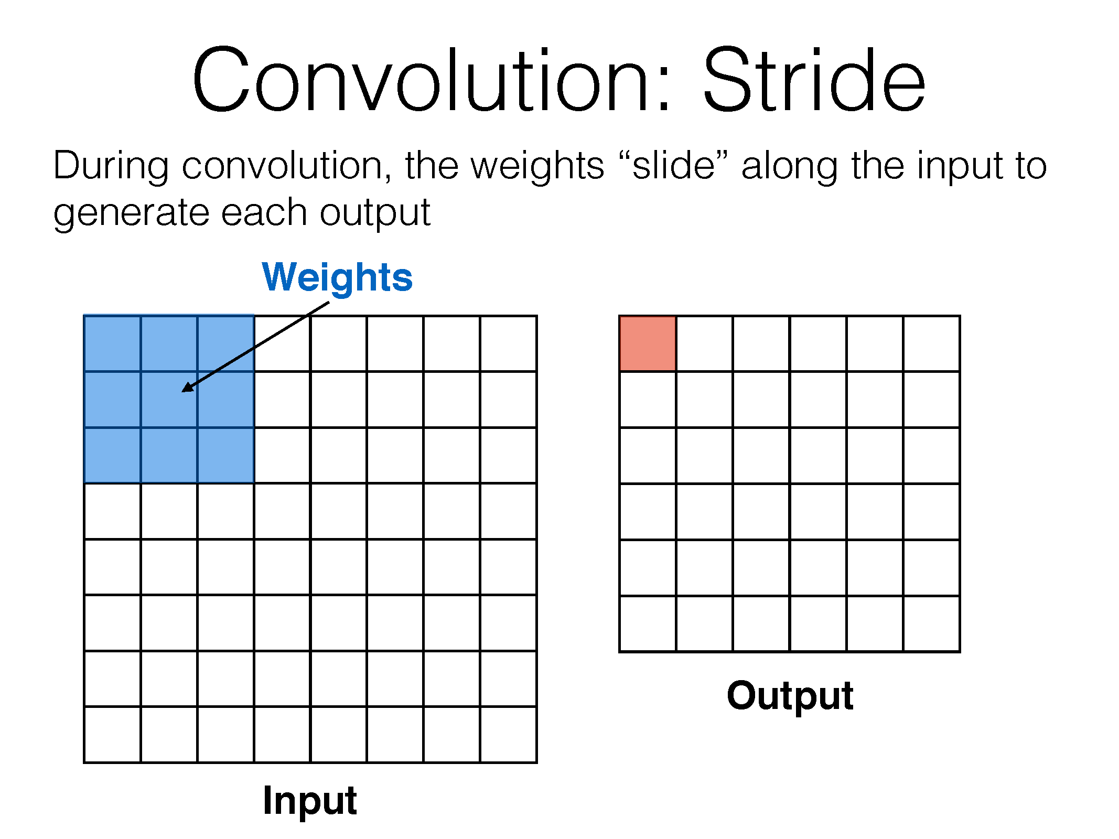

Slide 54
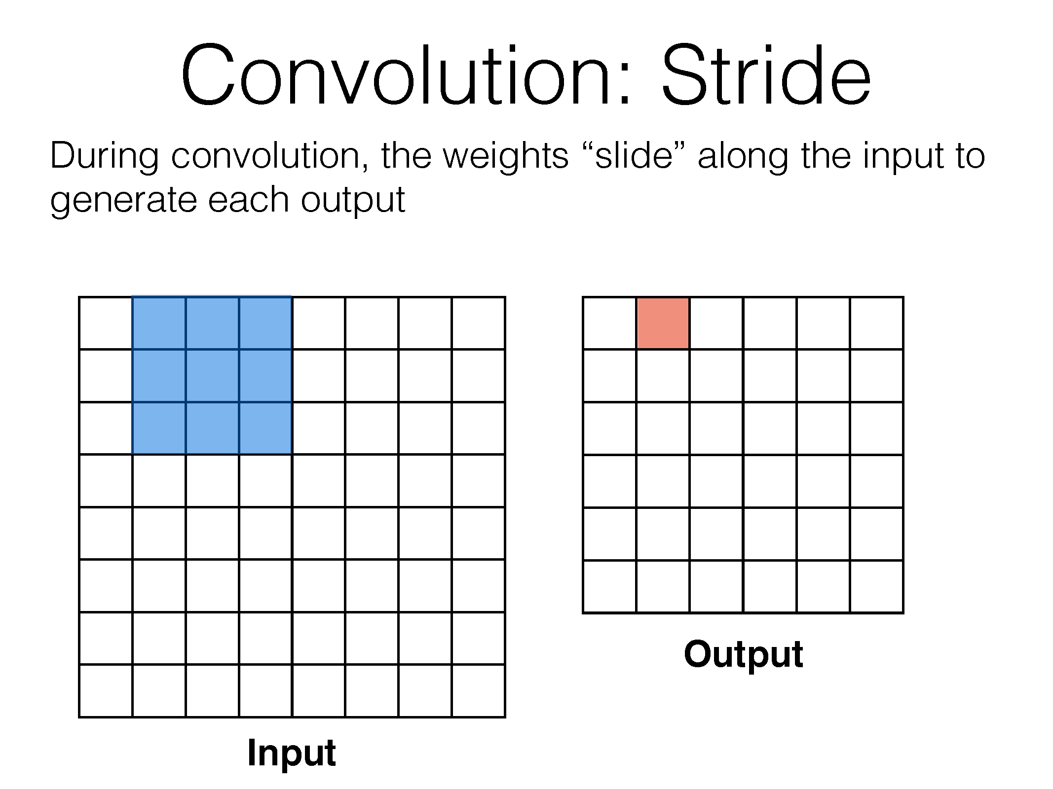

Slide 55
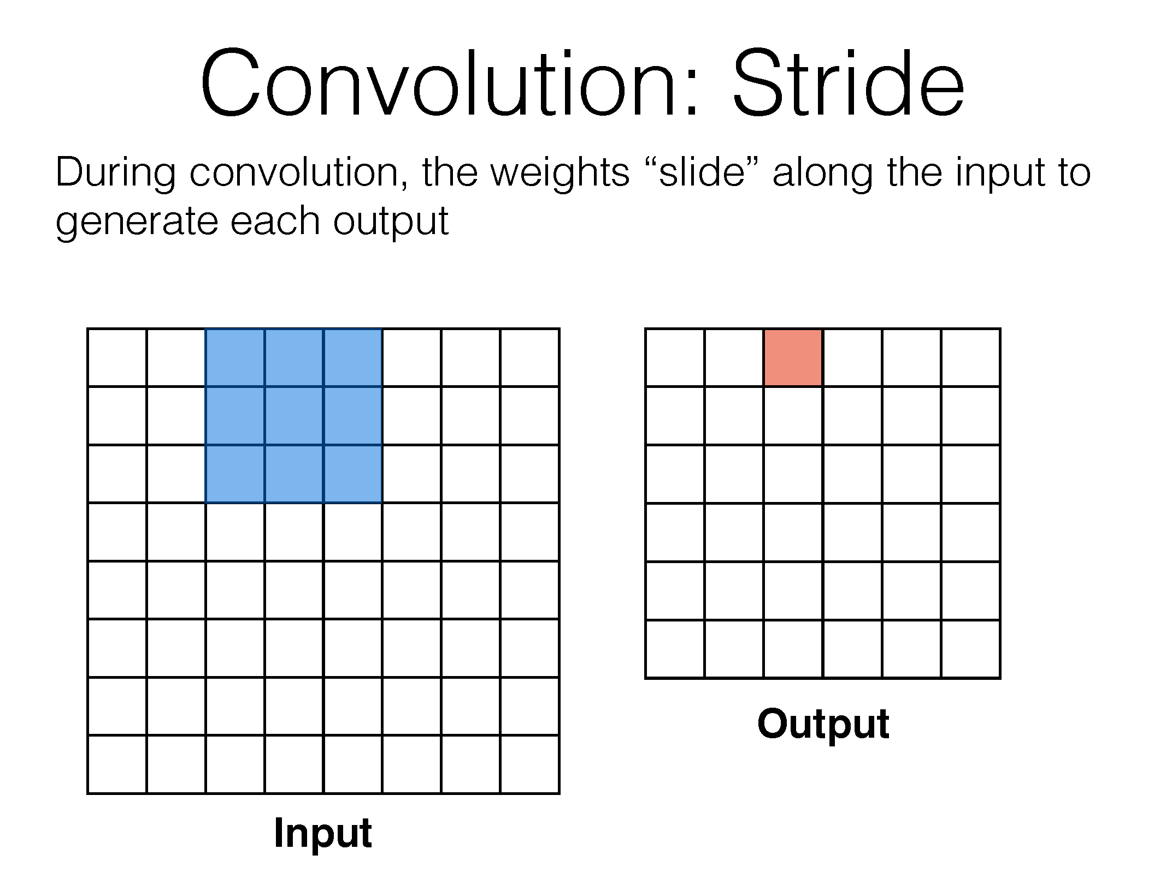

Slide 56
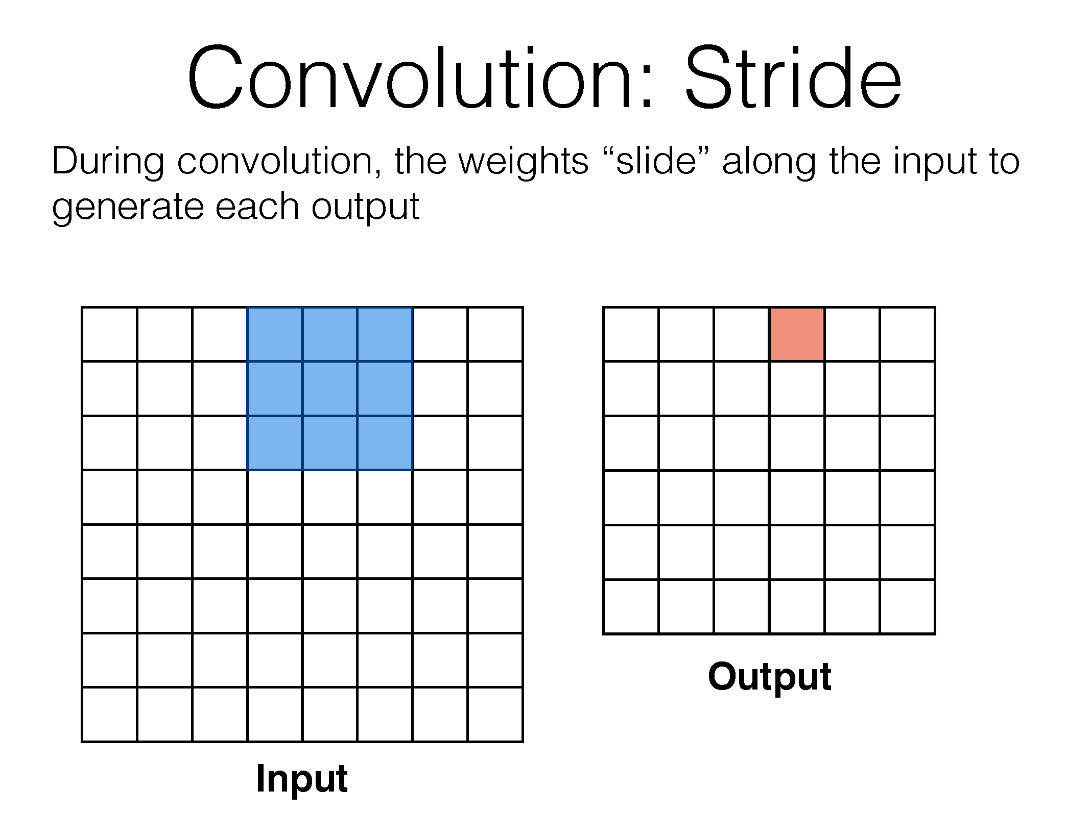

Slide 57
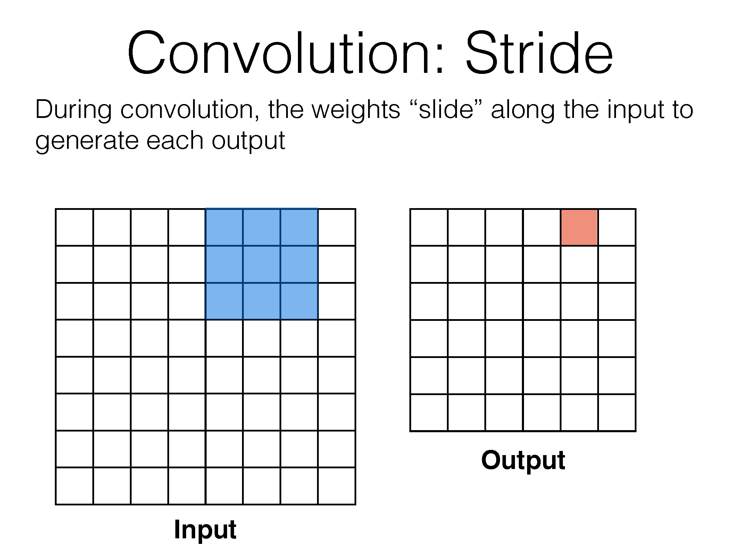

Slide 58
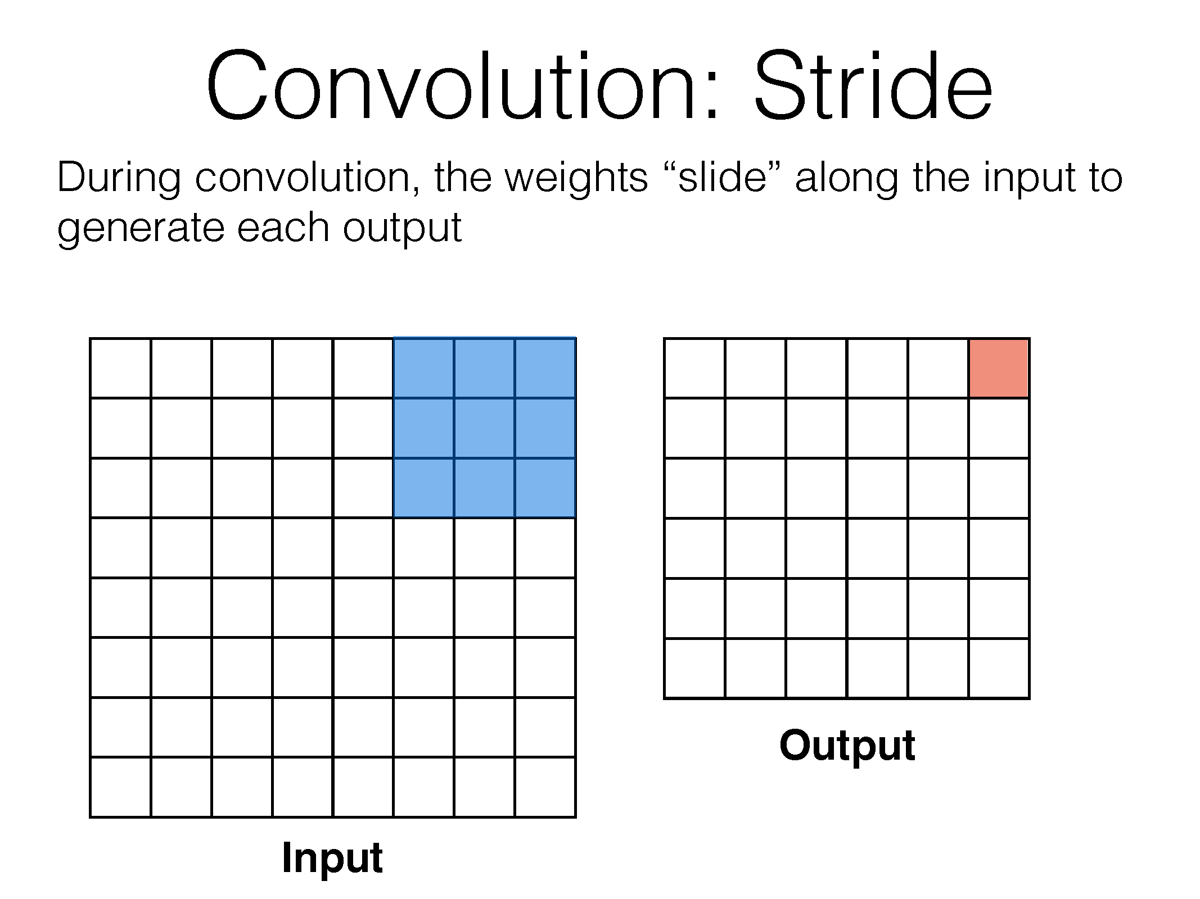

Slide 59
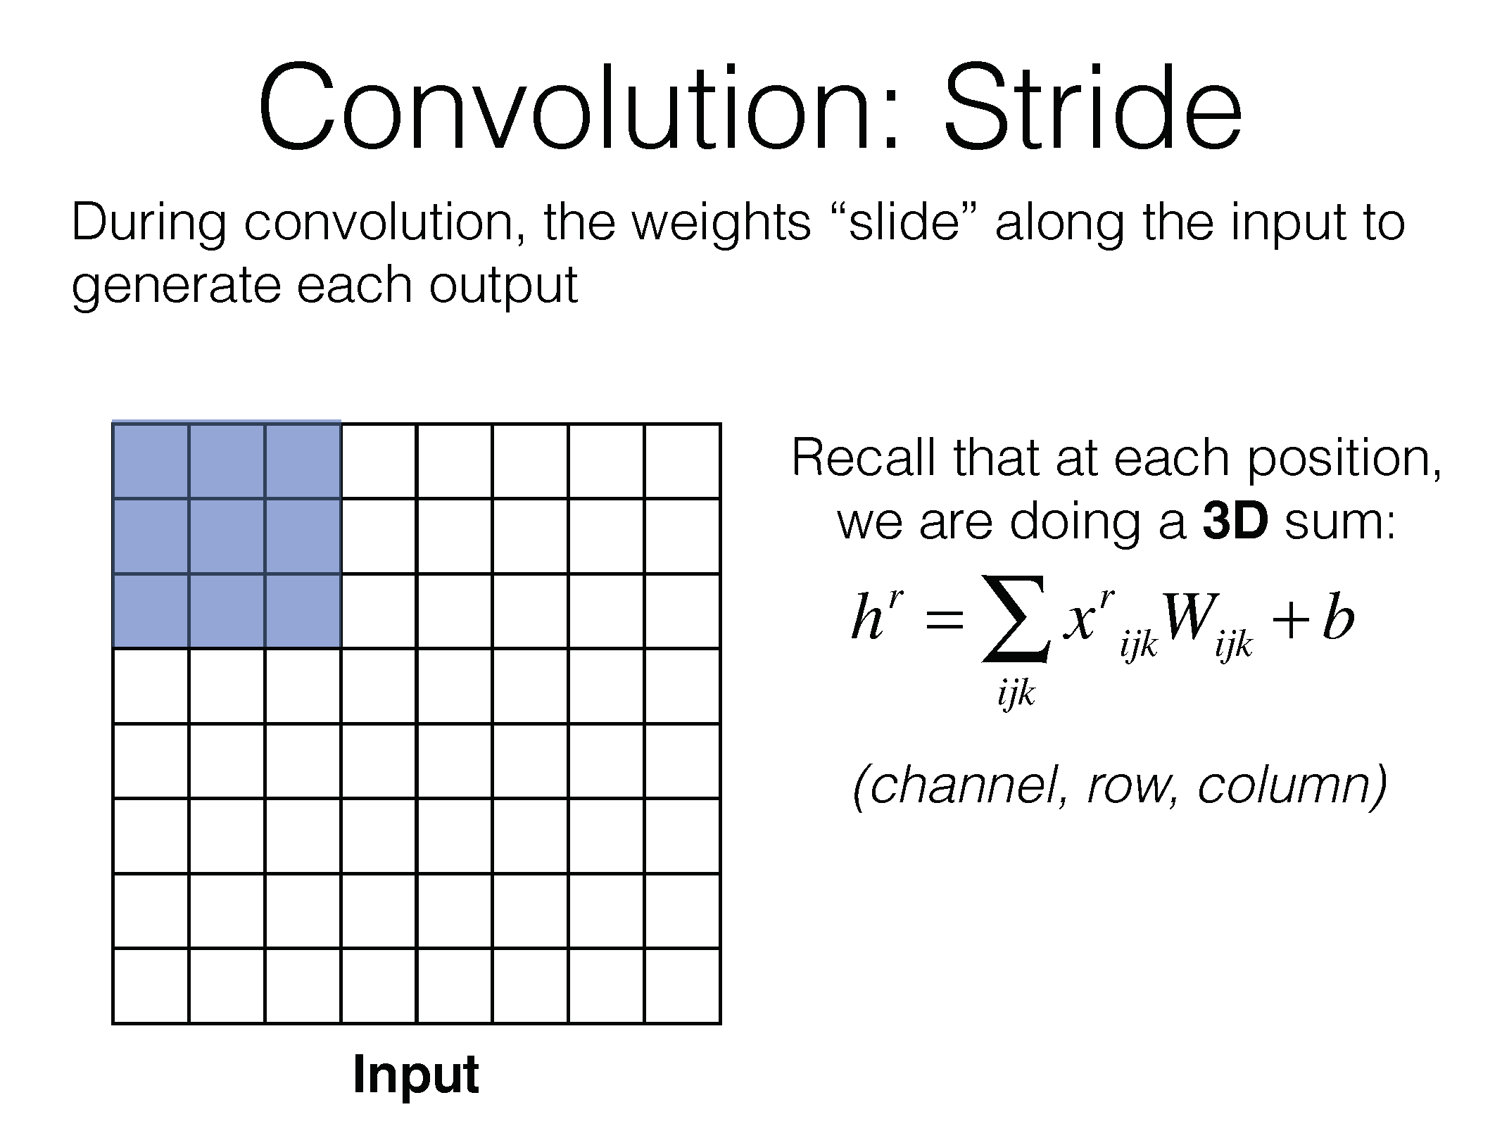

Slide 60
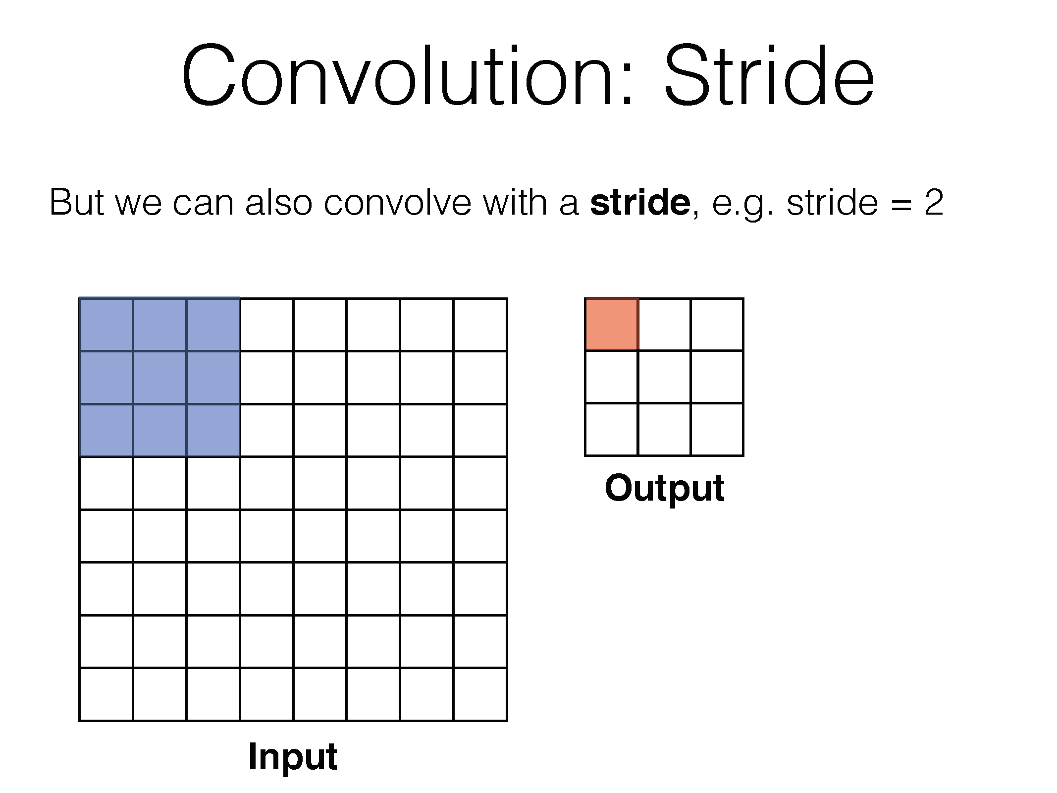

Slide 61
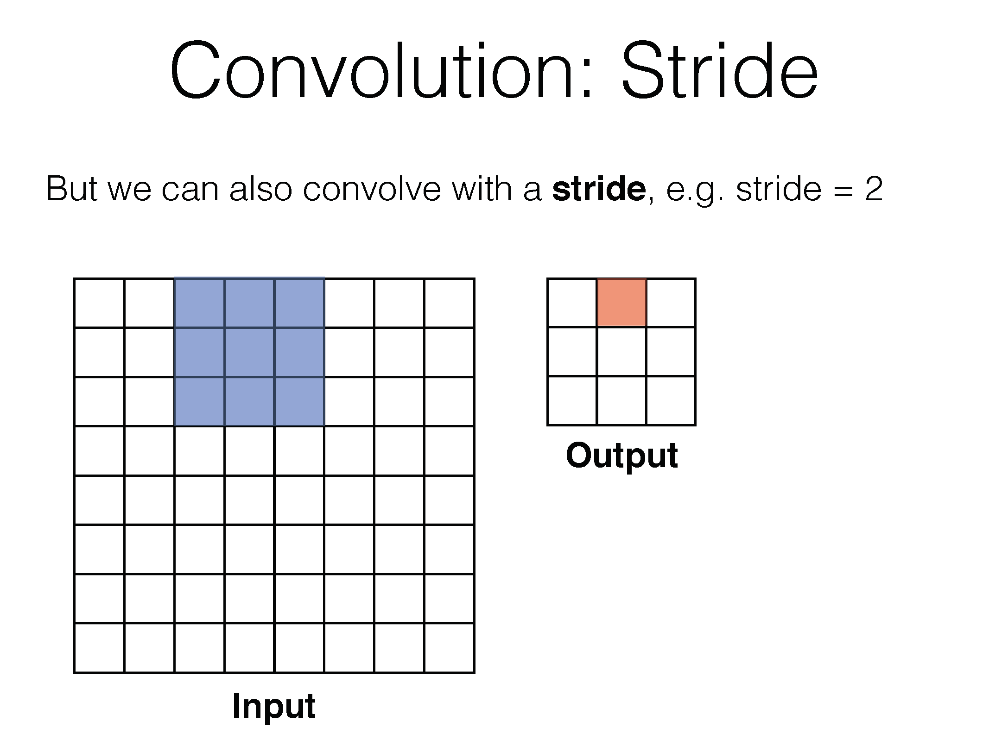

Slide 62
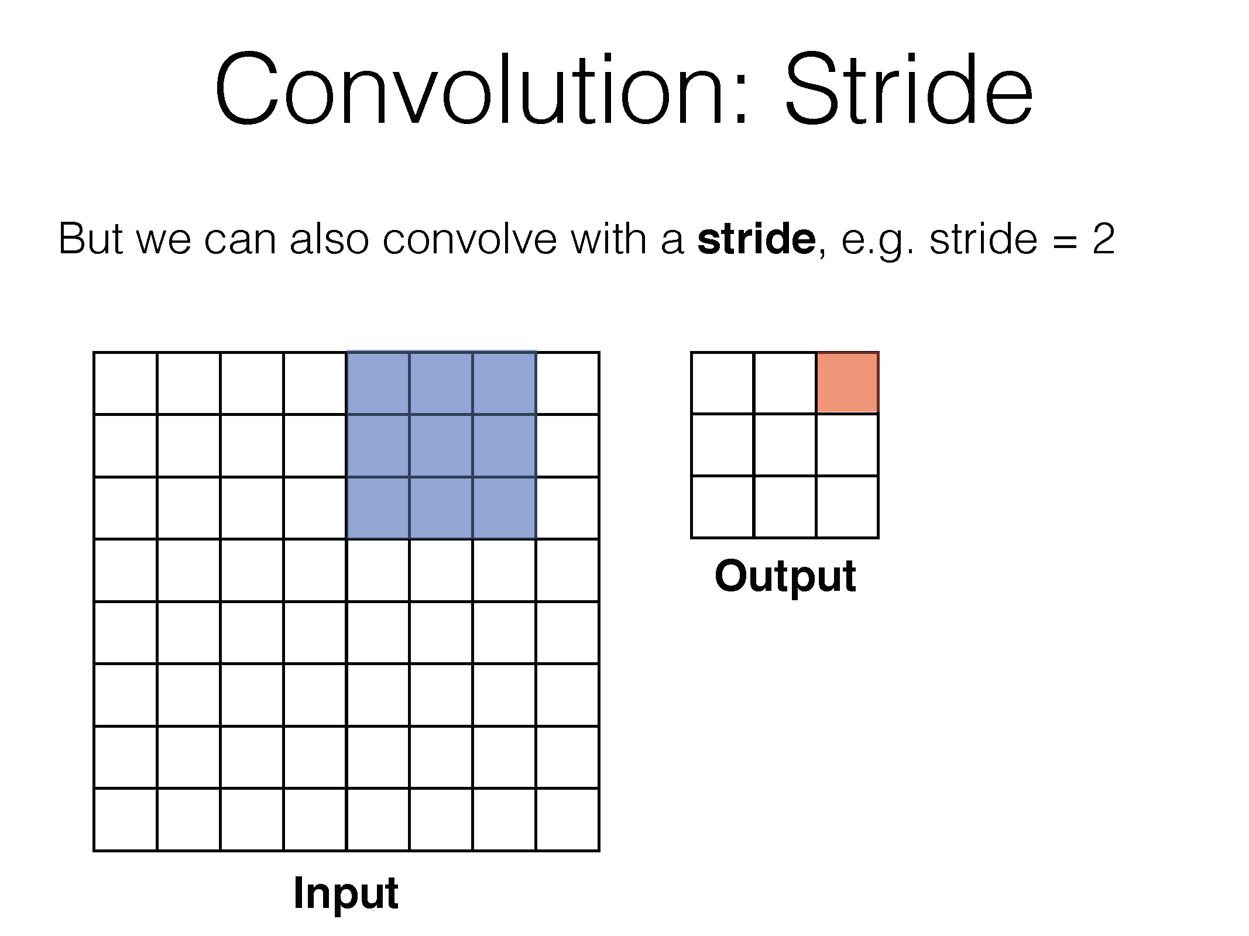

Slide 63


Slide 64


Slide 65


Slide 66


Slide 67


Slide 68


We can choose different parameters for the convolution:
$$w_{out}=\frac{w_{in}+2p−k}{s}+1$$
Such that $w_{out}$ is an int.

Slide 69

Prefer a stack of small filter CONV to one large receptive field CONV layer. Suppose that you stack three 3x3 CONV layers on top of each other (with non-linearities in between, of course). In this arrangement, each neuron on the first CONV layer has a 3x3 view of the input volume. A neuron on the second CONV layer has a 3x3 view of the first CONV layer, and hence by extension a 5x5 view of the input volume. Similarly, a neuron on the third CONV layer has a 3x3 view of the 2nd CONV layer, and hence a 7x7 view of the input volume. Suppose that instead of these three layers of 3x3 CONV, we only wanted to use a single CONV layer with 7x7 receptive fields. These neurons would have a receptive field size of the input volume that is identical in spatial extent (7x7), but with several disadvantages. First, the neurons would be computing a linear function over the input, while the three stacks of CONV layers contain non-linearities that make their features more expressive. Second, if we suppose that all the volumes have CC channels, then it can be seen that the single 7x7 CONV layer would contain $C×(7×7×C)=49C^{2}$parameters, while the three 3x3 CONV layers would only contain $C×(C×(3×3×C))=27C^{2}$parameters. Intuitively, stacking CONV layers with tiny filters as opposed to having one CONV layer with big filters allows us to express more powerful features of the input, and with fewer parameters.
From:http://cs231n.github.io/convolutional-networks/

Slide 70


Slide 71


Slide 72


Slide 73


Slide 74
Visualization example
https://www.youtube.com/watch?v=AgkfIQ4IGaM

Slide 75


Slide 76


Slide 77


Slide 78


Slide 79

Transfer learning

Slide 80


Slide 81


Slide 82


Slide 83


Slide 84


Slide 86


Slide 87


Slide 88


Slide 89


Slide 90


Slide 91


Slide 93


Slide 94


Slide 95


Slide 96


Slide 97


Slide 98


Slide 99


Slide 100


Slide 101


Slide 102


Slide 106


Slide 107


Slide 108


Slide 109


Slide 110


Slide 111


Slide 112


Slide 113


Slide 114


Slide 115


Slide 116


Slide 117


Slide 118


Slide 119


Slide 120


